Slide 1

GradeWise
Projects evaluation platform
Ido Beit On
Ohad Avidar
Tamar Fuchs

Slide 2
Introduction
What is GradeWise?
  GradeWise started last year, and we took on ourselves the mission of making it work.
  A web-based application designed to evaluate end of year projects.
  Supports two types of users: admin and judges.

Slide 3
Background
  Project management: Add and remove projects.
  Project assigning: Assign Judges to Projects.
  Grading system: Allows judges to grade projects.
  Final evaluation: Raw data without necessary analytics.

Slide 4

Motivation
Why GradeWise?
  Before GradeWise, the evaluation process was exhausting.
  Aviad, Dalit and Limor were using outdated methods.
  Need for an efficient and friendly grading system.

Slide 5



Technology Stack
End user
  Frontend: Built with React, including static files, components.
  Backend: An API server built with Node.js and Express.
  MongoDB: Used to store all necessary data.
  Docker: Each component is packaged in its own docker image.
  Cloud: Google Cloud Platform, Google Compute Engine.
Client (Frontend)
Server (Backend)
DataBase (Mongo DB)

Slide 6
Technology Stack
  Frontend: Built with React, including static files, components, and pages.
  React – A JavaScript UI library based on component composition.
  Backend: An API server built with Node.js and Express.
  Node.js – an asynchronous JS server
  Express – a library built on top of Node.js whose goal is to simplify server development by defining routes and handling HTTP methods.
  MongoDB: Used to store projects, grades, judges, and user data.
  A NoSQL document database (JSON-based)
  Docker: Each component is packaged in its own docker image.
  Enables packaging applications into self-contained containers that run reliably anywhere.
  Cloud: Google Cloud Platform, Google Compute Engine.

Slide 7
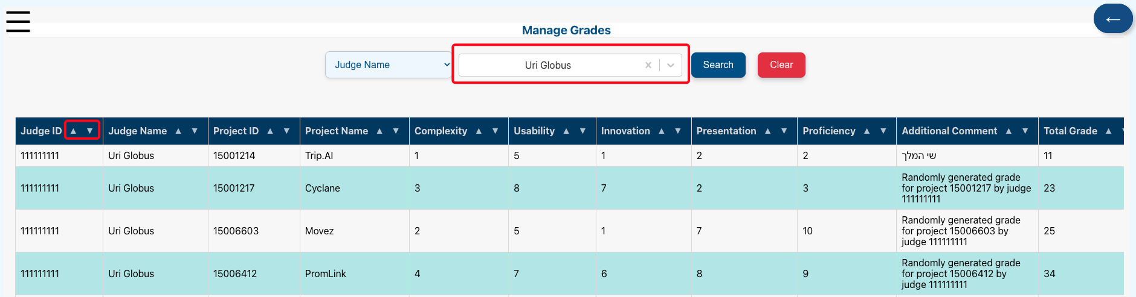
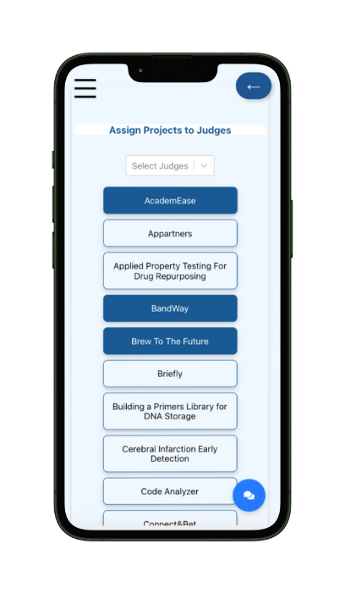
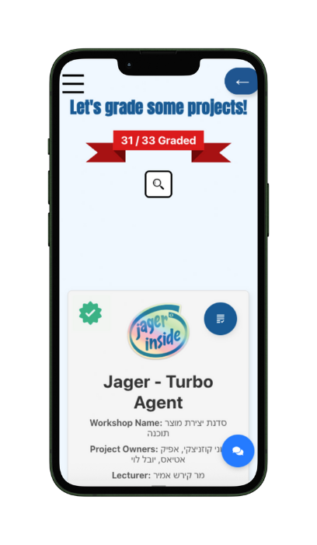
Key Features
  Fixed bugs: Making it work.
  Counter and indicator: Easily track how many projects you've evaluated and graded.
  Editable Evaluations: Revisit and update grades anytime.
  Mobile Compatibility

Slide 8
Ideas for future features
  View assignments between judges and projects.
  Average grades for each project (And not only top 3).
  Label and evaluate projects by categories.
  New welcome page.

Slide 9
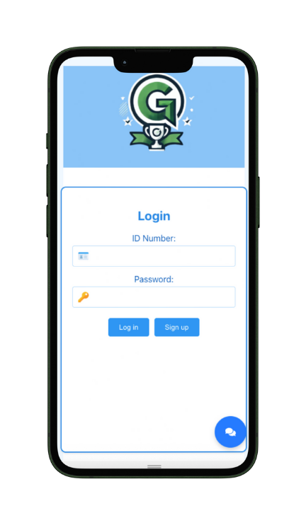
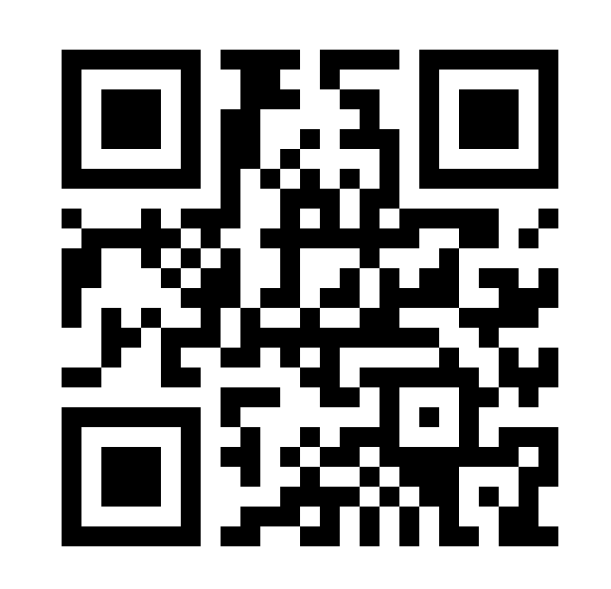
Thank you for your attention
now let's grade some projects!
Click to see GradeWise in action
For sign-up use the following ID’s
Dror ID: 000000001
Uri ID: 000000002

