Slide 1
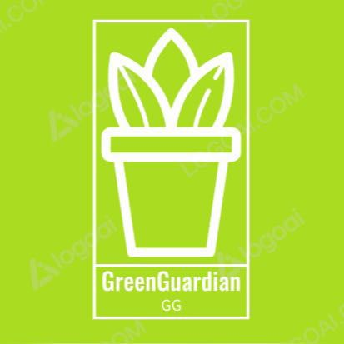
GreenGuardian Your plant's Guardian angle!
Project number :230403
Project members: Ido Fassberg, Shelly Golden, Yael Galili, Shay Ashkenazi
Mentors: Michal Brill Glasner and Benny Shapira

Slide 2
The problem
Have you ever tried to grow plants like mint at home but struggled to determine when to water them or why they weren't growing well? The journey of nurturing plants can be both rewarding and challenging, especially when it comes to understanding their unique care needs.
The Conundrum of Watering: Finding the right balance in watering your plants can be tricky.
The Mystery of Stunted Growth: You might have noticed your mint or other plants not thriving as expected.
The Dilemma of Plant Care: For those leading busy lives, it's often hard to keep a constant eye on your plants.
Notes:
Have you ever tried to grow plants like mint at home but struggled to determine when to water them or why they weren't growing well? The journey of nurturing plants can be both rewarding and challenging, especially when it comes to understanding their unique care needs.
The Conundrum of Watering: Finding the right balance in watering your plants can be tricky. Overwatering or underwatering can lead to wilting, root rot, and a host of other issues, leaving you puzzled about the proper watering regimen.
The Mystery of Stunted Growth: You might have noticed your mint or other plants not thriving as expected. Understanding the reasons behind stunted growth and how to address them becomes a puzzling endeavor.
The Dilemma of Plant Care: For those leading busy lives, it's often hard to keep a constant eye on your plants. You wish there was a way to monitor their health and moisture levels even when you're not physically present.

Slide 3
Our solution
Say hello to "GreenGuardian," your ultimate solution to conquer the challenges of plant care and gardening. Whether you're a beginner or an experienced gardener, Green Guardian is designed to be your virtual green thumb, ensuring your mint and other plants flourish effortlessly.
Fear not, for "Green Guardian" is here to be your reliable plant care monitoring system. As a cutting-edge mobile application, Green Guardian allows you to effortlessly keep track of your plants' moisture levels, ensuring they receive the precise care they require.
With its Arduino-based system and moisture sensor, you'll have peace of mind knowing that your plants are in good han.
Plant enthusiasts of all levels, from beginners to experienced gardeners.
Individuals seeking a user-friendly solution to monitor and care for their plants.
Anyone eager to embrace technology to enhance their plant parenting skills.

Slide 4
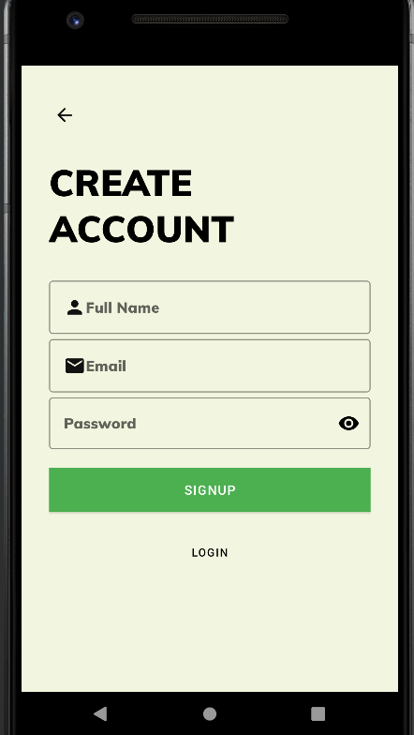
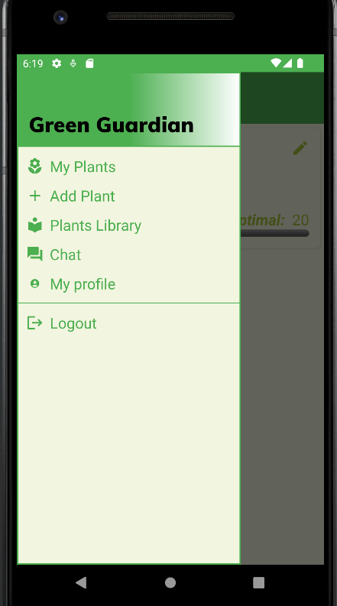
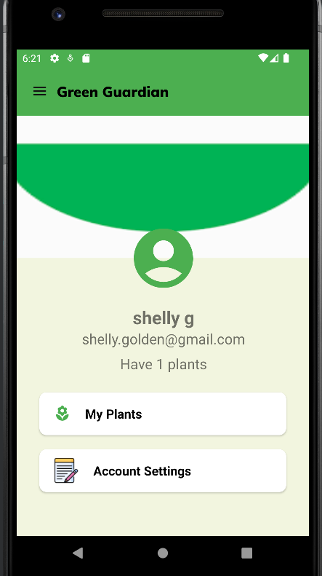
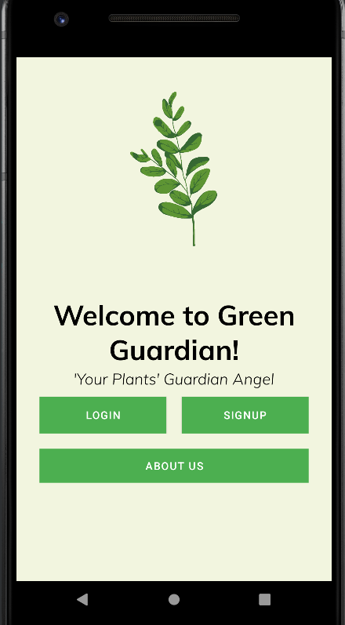
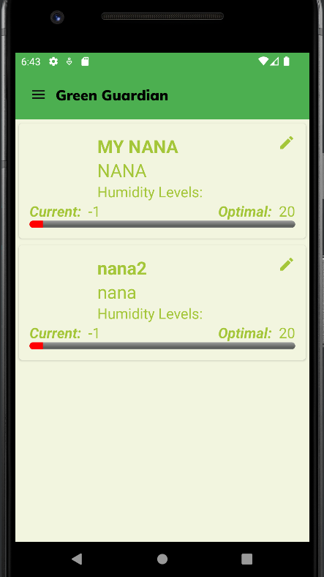
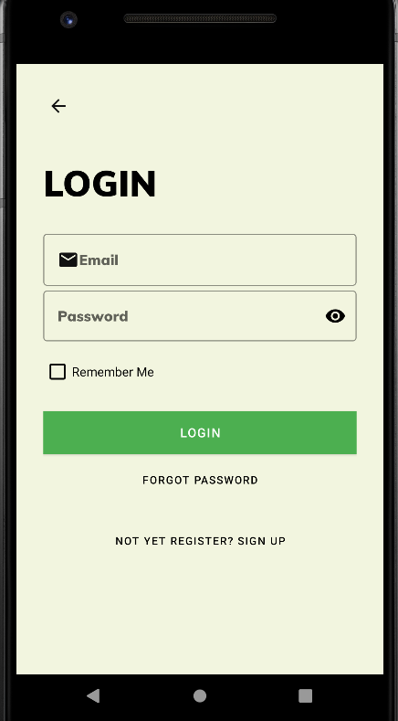
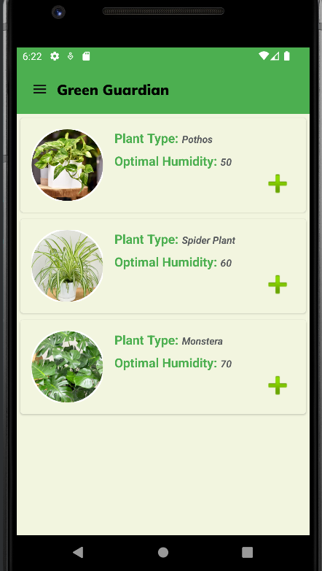
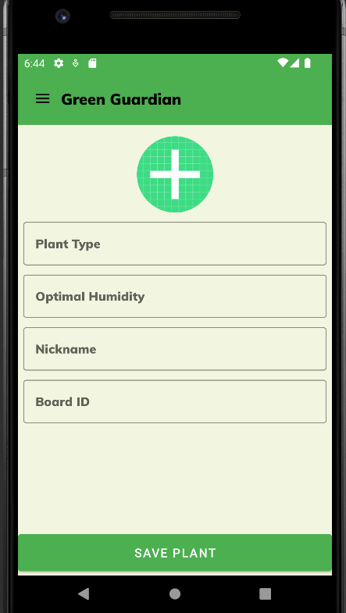
A little inside...

Slide 5
Our solution
In conclusion, Green Guardian is the ultimate plant care monitoring system designed to alleviate the challenges faced by plant lovers and enthusiasts alike.
Remote Monitoring: With the mobile application, you can keep an eye on your plants' health anytime, anywhere.
Customized Care: Each plant's specific moisture needs are met, promoting healthier growth and overall well-being.
Time-Saving: Green Guardian allows you to focus on other aspects of life while it takes care of your plants efficiently. The application sends timely notifications, letting you know precisely when to water your plants, sparing you from constant monitoring.

