Slide 1
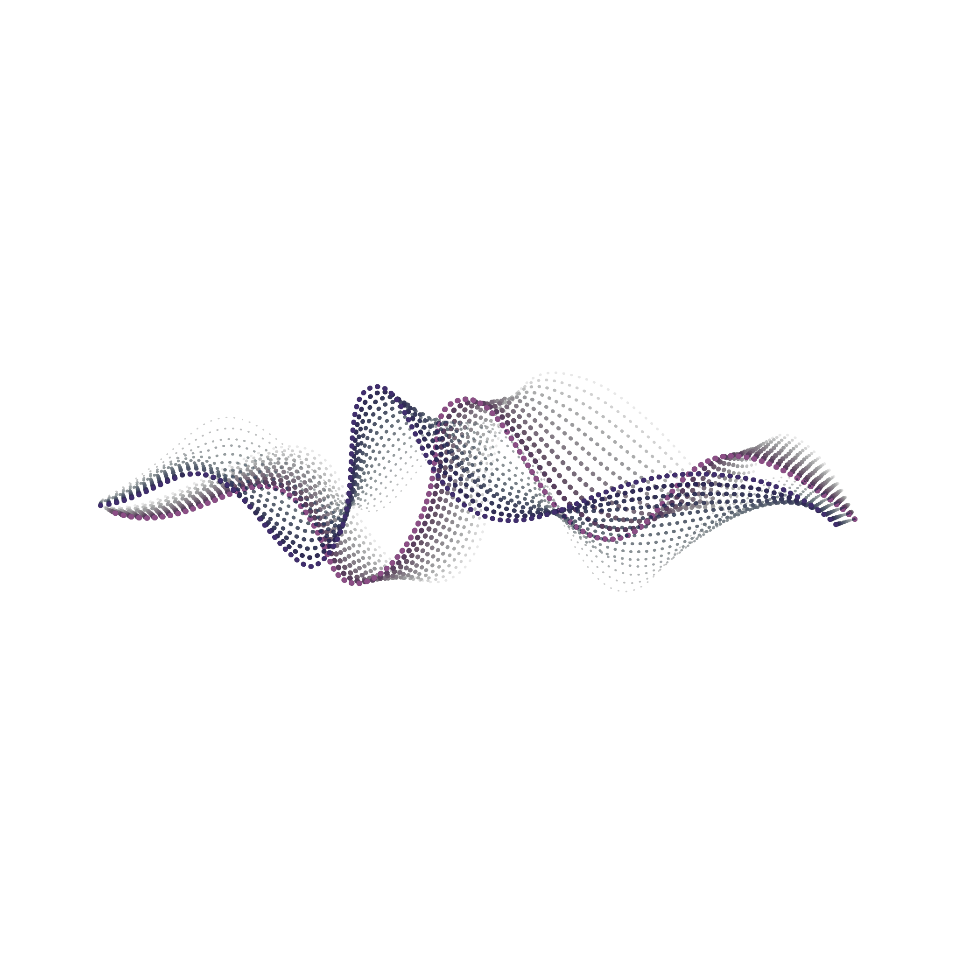
G2Net Detecting Continuous Gravitational Waves
Seminar in Machine Learning
Dr Sarel Cohen
Ron Chahmon and Aviv Markus

Slide 2
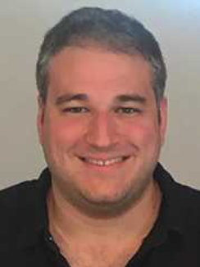
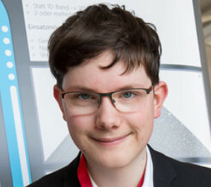
Research Team
Dr. Sarel Cohen
Senior Lecturer @ MTA
Prof. Peter Chin @ Dartmouth College, USA
Allison Mann
Ph.D. Candidate @ Boston University
Raphael Kunert
Master student @ Potsdam University, Germany
Aviv Markus
Student @ MTA
Ron Hachmon
Student @ MTA
Notes:
When do continuous gravitational waves occur?
They occur when there are massive objects in space that are spinning.
This could for example be two black holes orbiting each other, or a massive star spinning.
That emits long lasting gravitational waves.
When do continuous gravitational waves occur?
They occur when there are massive objects in space that are spinning.
This could for example be two black holes orbiting each other, or a massive star spinning.
That emits long lasting gravitational waves.

Slide 3
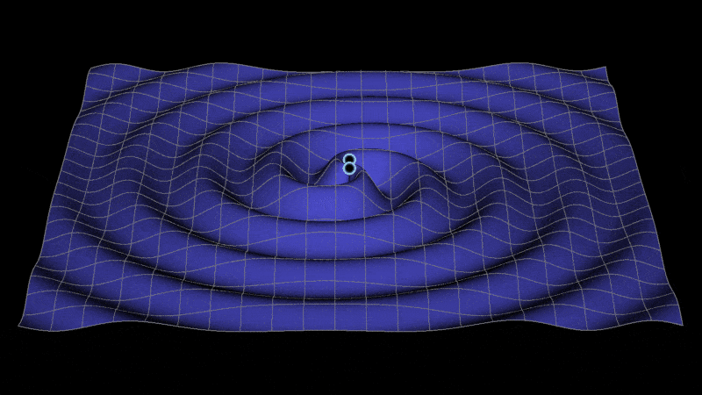
When do continuous gravitational waves occur?
massive spinning objects
Notes:
When do continuous gravitational waves occur?
They occur when there are massive objects in space that are spinning.
This could for example be two black holes orbiting each other, or a massive star spinning.
That emits long lasting gravitational waves.
When do continuous gravitational waves occur?
They occur when there are massive objects in space that are spinning.
This could for example be two black holes orbiting each other, or a massive star spinning.
That emits long lasting gravitational waves.

Slide 4
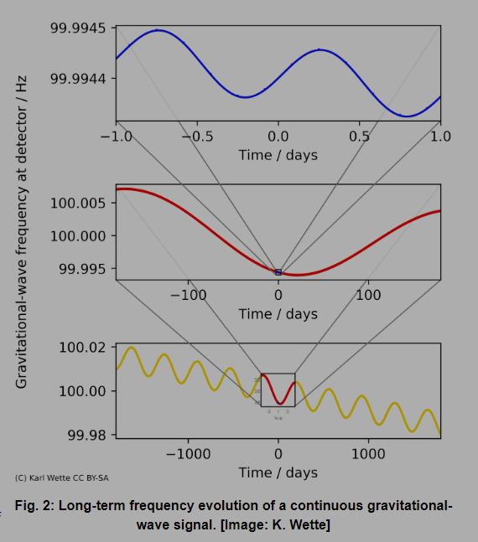
LIGOs Laser Interferometer Gravitational-Wave
Notes:
We can observe these gravitational waves using so called LIGOs Laser Interferometer Gravitational-Wave Observatorys.
When observing, we get the following graphs (on the right)
The observed frequency of the gravitational wave changes over time, because:
LIGO rotating around the center of the earth
The earth rotating around the sun
The system or object emitting the GWs is losing energy and thus spinning slower
How did scientists detect gravitational waves in the past and are still doing it today?
They took the data and take different waves at different frequencies to put them over the measured values.
With that, they try to find correlations in the data
If the corrolation is high, it is very likely, that there is a gravitational wave with that frequency in the data
How does the challenge provide the data?

Slide 5
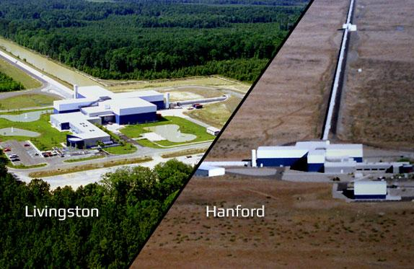
L1
SFTs
timestamps_GPS
H1
SFTs
timestamps_GPS
frequency_Hz
Data Source
Notes:
When do continuous gravitational waves occur?
They occur when there are massive objects in space that are spinning.
This could for example be two black holes orbiting each other, or a massive star spinning.
That emits long lasting gravitational waves.
When do continuous gravitational waves occur?
They occur when there are massive objects in space that are spinning.
This could for example be two black holes orbiting each other, or a massive star spinning.
That emits long lasting gravitational waves.

Slide 6
What’s The problem?

Slide 7
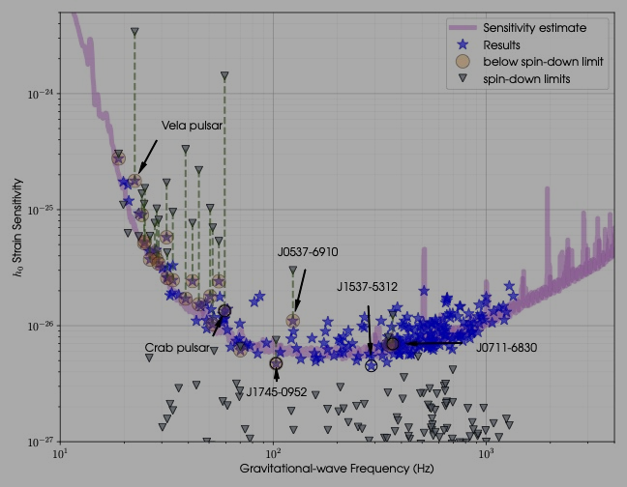
Goal of the Competition
find continuous
gravitational-wave signals!

Slide 8
Kaggle Leader board

Slide 9
Our Approach
The goal of this competition is to find continuous gravitational-wave signals from rapidly-spinning neutron stars within noisy data.
Quantity of the training data is crucial for developing a sensitive and robust model.
We worked on a data generator class that can simulate realistic and static noise, as well as different types of signals with various parameters.
We used the data generator to augment the original training data and create new samples with different noise levels and signal characteristics.
We also analyzed the statistical properties of the kaggle dataset and the generated data to ensure consistency and diversity.
Notes:
This could for example be two black holes orbiting each other, or a massive star spinning.
That emits long lasting gravitational waves.
When do continuous gravitational waves occur?
They occur when there are massive objects in space that are spinning.
This could for example be two black holes orbiting each other, or a massive star spinning.
That emits long lasting gravitational waves.

Slide 10
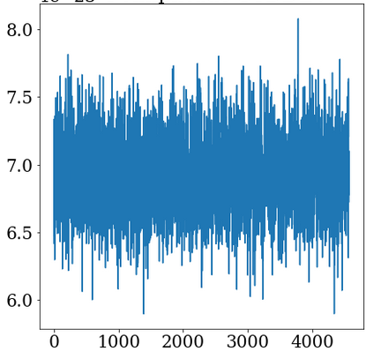
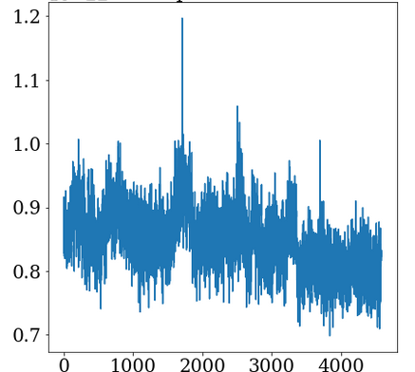
Solution Architect
Our solution consists of three main components: data generator, data preprocessor and model.
The data generator creates new training samples with realistic and static noise, and different types of signals with various parameters.
The data preprocessor applies a series of transformations to the raw data, such as bandpass filtering, spectrogram extraction and normalization.
The model is a convolutional neural network (CNN) that takes the spectrograms as input and outputs a probability of signal presence for each sample.
We trained the model using cross-validation and optimized the hyperparameters using Bayesian optimization.
Notes:
When do continuous gravitational waves occur?
They occur when there are massive objects in space that are spinning.
This could for example be two black holes orbiting each other, or a massive star spinning.
That emits long lasting gravitational waves.
When do continuous gravitational waves occur?
They occur when there are massive objects in space that are spinning.
This could for example be two black holes orbiting each other, or a massive star spinning.
That emits long lasting gravitational waves.

Slide 11
Possible Solutions
Besides our solution, there are other possible approaches that we considered or learned from the competition. Some of them are:
Few shot learning: using a small amount of high quality training data to train a CNN classifier, and applying some noise reduction techniques to the raw data.
Vision Transformer: using a transformer-based model to learn the features and location of the signals from the spectrograms.
Denoiser: using an AI denoiser to remove some level of noise from the raw data, and then using a CNN classifier to detect the signals.
Notes:
When do continuous gravitational waves occur?
They occur when there are massive objects in space that are spinning.
This could for example be two black holes orbiting each other, or a massive star spinning.
That emits long lasting gravitational waves.
When do continuous gravitational waves occur?
They occur when there are massive objects in space that are spinning.
This could for example be two black holes orbiting each other, or a massive star spinning.
That emits long lasting gravitational waves.

Slide 12
If I have seen further it is by standing on the shoulders of Giants
Transformer
data loading
data generation
fast.ai
CRNN
ResNet
efficentnet
k-nearest neighbours
real and generated data
CNN with large kernels
CNNs with folding
Notes:
When do continuous gravitational waves occur?
They occur when there are massive objects in space that are spinning.
This could for example be two black holes orbiting each other, or a massive star spinning.
That emits long lasting gravitational waves.
When do continuous gravitational waves occur?
They occur when there are massive objects in space that are spinning.
This could for example be two black holes orbiting each other, or a massive star spinning.
That emits long lasting gravitational waves.

Slide 13
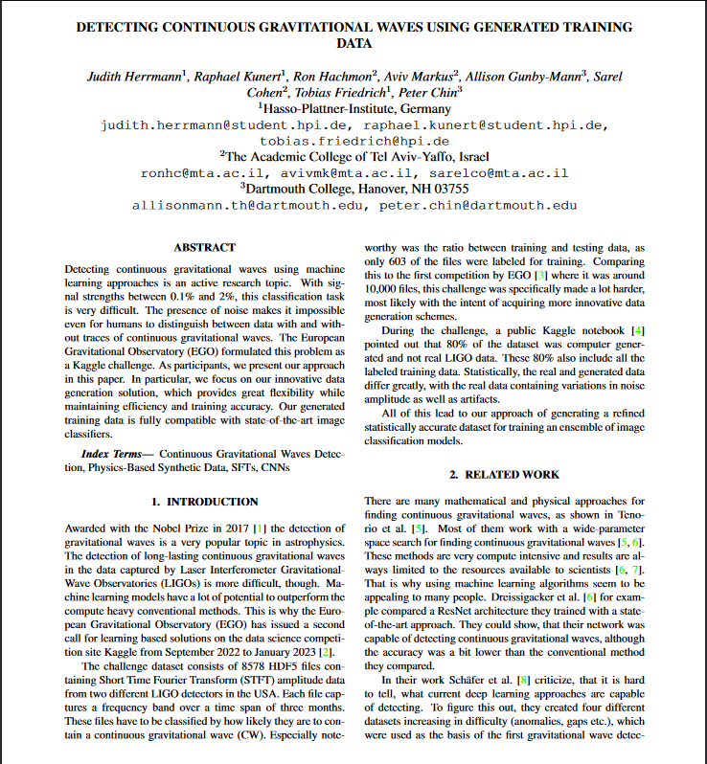
We Submitted an IEEE Paper
Notes:
When do continuous gravitational waves occur?
They occur when there are massive objects in space that are spinning.
This could for example be two black holes orbiting each other, or a massive star spinning.
That emits long lasting gravitational waves.
When do continuous gravitational waves occur?
They occur when there are massive objects in space that are spinning.
This could for example be two black holes orbiting each other, or a massive star spinning.
That emits long lasting gravitational waves.

Slide 14
Conclusion
In this research, we developed a solution for finding continuous gravitational-wave signals from rapidly-spinning neutron stars within noisy data.
Our solution consists of three main components: data generator, data preprocessor and model.
We improved the quality and quantity of the training data by using the data generator to create new samples with realistic and static noise, and different types of signals with various parameters.
We used a convolutional neural network (CNN) to classify the spectrograms as signal or noise, and optimized the hyperparameters using Optuna optimization.
We submitted an IEEE paper
Notes:
When do continuous gravitational waves occur?
They occur when there are massive objects in space that are spinning.
This could for example be two black holes orbiting each other, or a massive star spinning.
That emits long lasting gravitational waves.
When do continuous gravitational waves occur?
They occur when there are massive objects in space that are spinning.
This could for example be two black holes orbiting each other, or a massive star spinning.
That emits long lasting gravitational waves.

Slide 15
Questions?
Notes:
When do continuous gravitational waves occur?
They occur when there are massive objects in space that are spinning.
This could for example be two black holes orbiting each other, or a massive star spinning.
That emits long lasting gravitational waves.
When do continuous gravitational waves occur?
They occur when there are massive objects in space that are spinning.
This could for example be two black holes orbiting each other, or a massive star spinning.
That emits long lasting gravitational waves.

