Slide 2
About us:
Team
Project
Subject
Amit Leibovitch Nikol Rafalovich Eden Azulay Tomer Gilad
#231103 Cloud based development Mentor: Yogev Shani
Managing private Confectionery business

Slide 3
The problem
Many confectioners are having a hard time calculating the correct cost of the pastries they are making.
Most of them are managing an Excel file that contains the prices of the ingredients, which is being updated manually.
With this Excel file, the confectioners are deciding the prices of the pastries, which are calculated according to their costs.
Ingredient’s price is changed frequently.
Therefore, it is neither easy nor convenient to manage this Excel file.
This is where we come in!

Slide 4
Our product:
An easy solution for private confectioners and chefs, that is meant to help them organize their work- among themselves and among their customers.
Here we enter, with our website, we help the confectioners calculate their recipe's cost.
This is due to a large database of ingredients that are updated frequently with the current market prices.
In addition, we give the confectioners the option to manage their orders.

Slide 5
How will our product achieve these goals?
Data management:
A well-organized recipes list, including ingredients, quantities and option to multiply the recipe.
Cost calculator per order, including the ingredients prices (cost price) and work time.
Auto-generated ingredients list from several big supermarkets, that will update automatically every week.
Option to add manual ingredients (with manual price)
Select highest cost possible, lowest cost possible, or average cost (depends on the supermarket)

Slide 6
How will our product achieve these goals?
Customer management:
Keep a customers list, and their contact info (name, phone number, email…)
For each customer- keep his order history
For a customer with an active order- update him via SMS on his/her order status, with a pre-made SMS template.

Slide 7
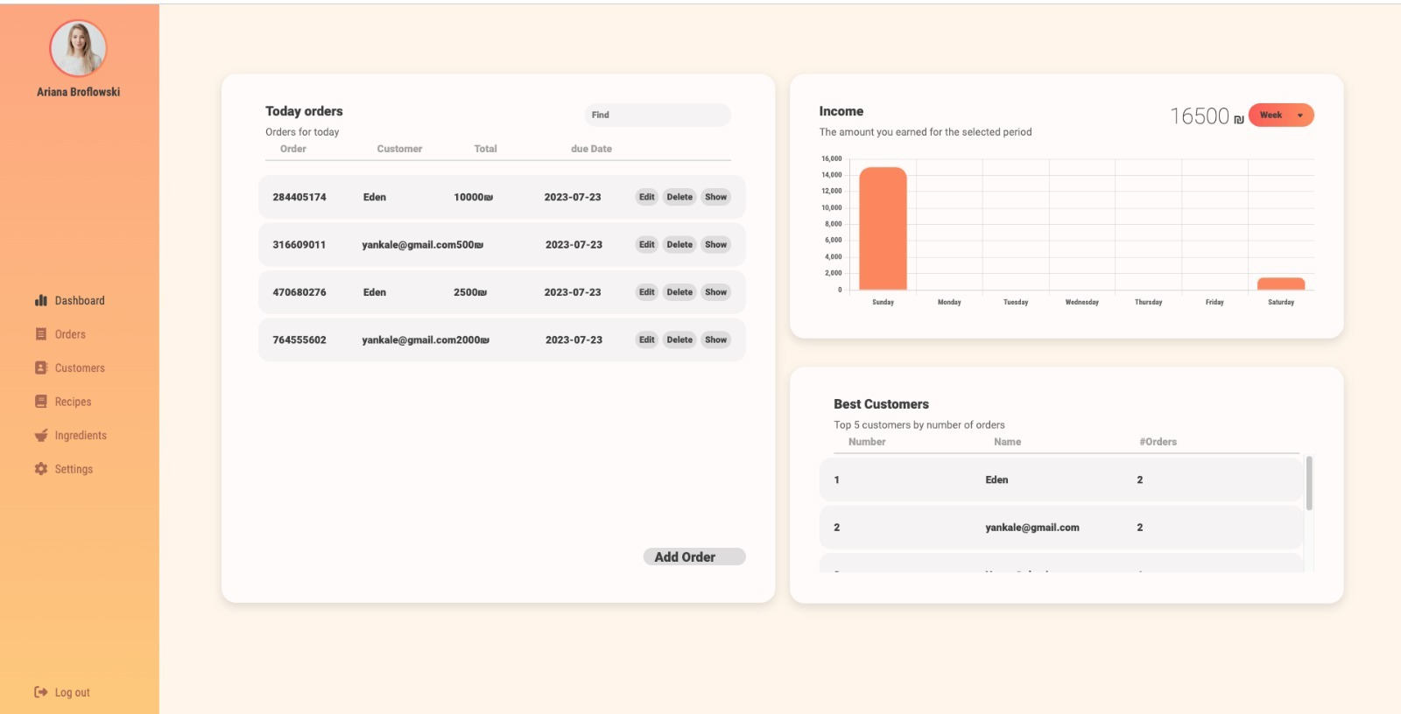
Demonstration

Slide 8
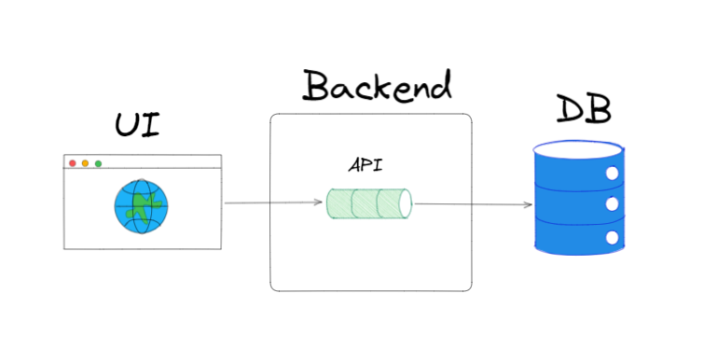
Behind the scenes: Main components:
Our system will include the following main components:
UI - That will be used to interface between the user and the system. It will show all the information the system holds and allow the user to enter new data.
API - A standard API (in our project, it will be used by the UI), and it will interface between the UI and the backend.
DB - The DB will save all the information of the
entities saved in the system.

Slide 9
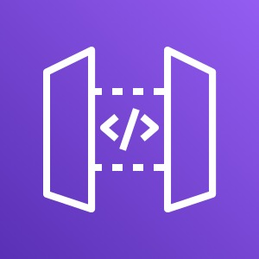
Behind the scenes: Main components:
Backend
API Gatway
AWS Lambdas
UI (AWS EC2)
DB
SNS
Cognito
Logs and monitoring

Slide 10
Possible Solutions
Other possible solutions for this problem
The single solution that we managed to find, only allowed a single table to create a recipe without manual ingredients pricing.
The advantage of MakeCake
Ingredients cost updated manually according to market prices.
Customers and orders are easily managed using a single website.

Slide 11
Working with AWS lab
AWS simplified many aspects of our development, for example authentication (Cognito), integration between backend and front end (API gateway).
We got to experience the development process of serverless applications (lambda functions), monitor it with logging service (Cloud Watch), and new non-relational data base(DynamoDB).
Working with the lab has been convenient but it has it’s limitations. When trying to use modules that require IAM’s specific Polices and Roles, we were blocked. For example, when adding a phone number to SNS sandbox using lambda function, the lambda got errors due to inefficient permissions.

Slide 12
Summary
With MakeCake, you can fully manage your confectioner business with just one simple online interface.
Keep track of your income
﻿﻿Manage your customers' orders
﻿﻿Update your customers with our ready-to-use SMS templates
﻿﻿Get an auto-calculated cost for each order
﻿﻿Get costs according to the market's current prices

