Slide 1
VR
Quidditch
Presenting: Dan Amoyal, Eden Benzimra & Nimrod Goldberger
Project №: 231404
Workshop: Unity Game Development
Instructor: Moshe Sulamy

Slide 2
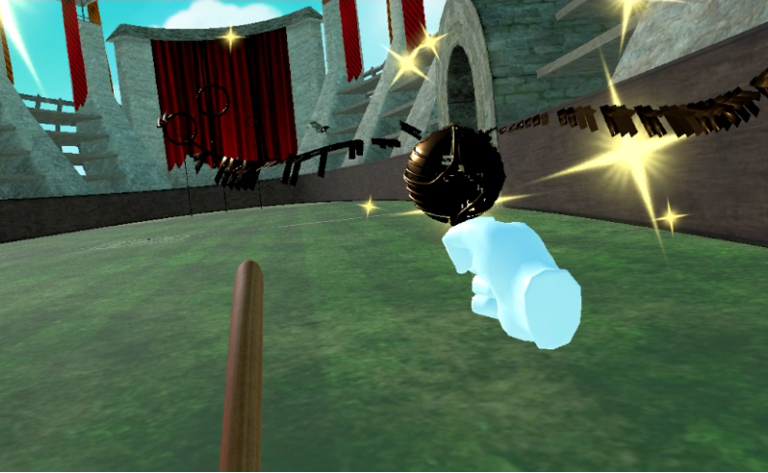
Have you ever dreamt of flying?
If so, VR Quidditch is a game for you:
New yet nostalgic first person experience
Simulates the famous sport from the magical universe of Harry Potter
Fly on a broom like our favorite wizards
Cast spells with your voice
Dodge the Bludgers coming to crush you
Score goals and chase the Snitch
Notes:
Nimrod

Slide 3
Have you ever dreamt of flying?
If so, VR Quidditch is a game for you:
New yet nostalgic first person experience
Simulates the famous sport from the magical universe of Harry Potter
Fly on a broom like our favorite wizards
Cast spells with your voice
Dodge the Bludgers coming to crush you
Score goals and chase the Snitch
Play against a friend in multiplayer

Slide 4
Goals
✦
✸
✹
Immersion
Control
Thrill
An experience that pulls you into the magical world of witchcraft and wizardry.
Fully control your flight and gameplay in a way that makes you feel like an athletic wizard.
The most important part of any video game is to provide an engaging gameplay experience.
Notes:
Dan

Slide 5
Solutions
✦
✸
✹
Immersion
Control
Thrill
Squeeze your broom to go faster, cast spells with your voice, grab objects with your free hand...
Every component of the Oculus Quest II is used for this: Gyroscopes, microphones, sticks and buttons
Constantly balance your different priorities: Dodge, score, chase, lead and strategize.
Notes:
Dan

Slide 6
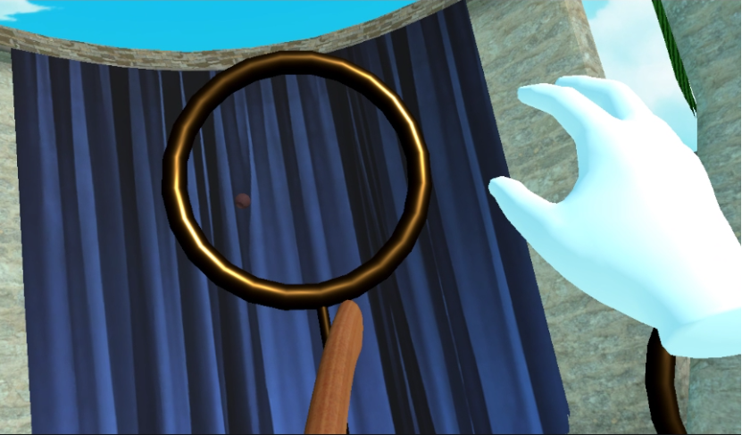
Gameplay
The Rules of Quidditch:
✦ Score 10 points by throwing the Quaffle into the goalpost.
✦ Immediately get 150 points for catching the Snitch and end the game.
✦ Avoid Bludgers (you don’t have to but you should).
Notes:
Eden

Slide 7
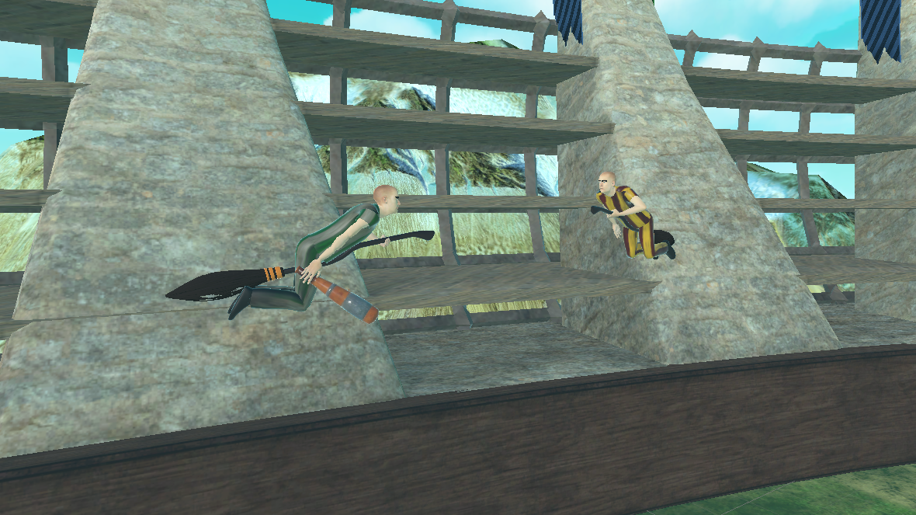
Gameplay
Implementation:
✦ Your left hand controls the flight direction, point it where you want to go. Squeeze to go faster.
✦ Use your right hand to grab and throw Quaffles, catch the Snitch, or try to stop a Bludger.
✦ Activate voice commands and speak the right words to cast spells!
Notes:
Nimrod

Slide 8
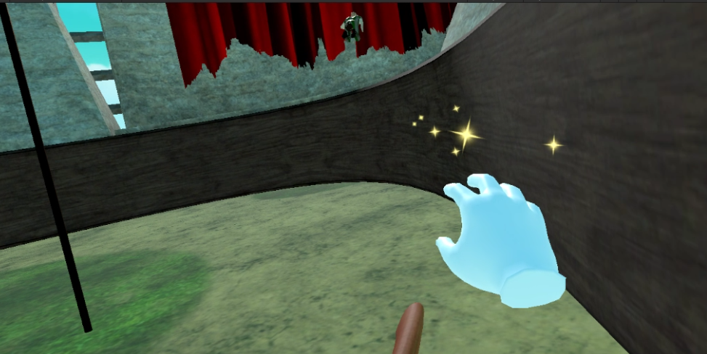
Screenshots

Slide 9
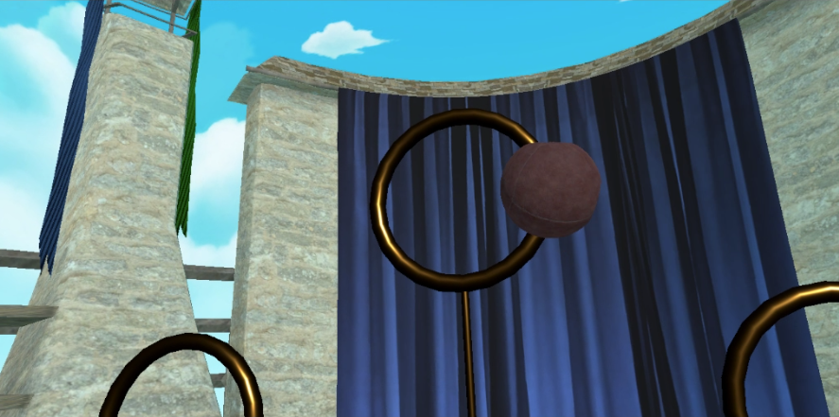
Screenshots

Slide 10
Video
https://www.youtube.com/watch?v=JWvvsBXZ0yY
Notes:
Eden

Slide 11
Architecture
Controls:
The source of forward movement is tied to the front of the broom, enabling you to fly anywhere you point it.
Voice commands are handled by Wit.AI online.
Quidditch Equipment & AI:
AI will rotate between a few states e.g. Patrol, Idle, Chase...
Coordinates are calculated by scaling products of an ellipse standard equation.
A hidden timer controls the flow of gameplay, making the Snitch easier to catch.
Notes:
Nimrod

Slide 12
Multiplayer
Using Photon PUN2:
Low latency connections for 2 player duels.
Synchronized AI interactions.
Synchronized game object physics interactions.

Slide 13
Alternatives
Unity’s Netcode for Game Objects package allows you to implement your own multiplayer system but we ran into many limitations on Client side prediction/updating. Though it is a third party service, Photon PUN2 handles these issues smoothly.

Slide 14
Alternatives
We decided to use Rigidbody physics based movement (applying force on an object in a certain direction) instead of setting a new position every update. This allows us to better detect object collisions gives better visuals e.g. a Bludger may start spinning after getting hit on it’s side.
Notes:
Dan

Slide 15
Summary
A fun casual dueling game to play with friends.
Uses every input you can get from the Oculus Quest II.
Old themes with new technology.
Flying around on a broom is already fun, Quidditch is just the cherry on top.
Notes:
Nimrod

