Slide 1
FoodWise
Project number: 15006504
Mentor: Gili Kamma
Igal Kaminski
Michael Shuster
Lior Barak

Slide 2
Table of contents
01
02
03
04
Why?
The Product
Structure And Architecture
Our Progress

Slide 3
01
Why?

Slide 4
The Problem
Inefficiency and lack of intelligent management in traditional refrigerators.
Conventional refrigerators do not provide real-time monitoring, inventory management, or personalized user assistance.
Current high cost of smart refrigerators presents a significant barrier to widespread adoption which limits accessibility for a broader demographic.

Slide 5
The Solution
Cost-effective Internet of Things (IoT) device designed to be seamlessly integrated with conventional refrigerators.
The device employs a scanner to add and remove items from the refrigerator.
A user-friendly mobile application, individuals can effortlessly monitor their food inventory in real-time, receive automated expiration alerts, and efficiently create shopping lists based on actual usage.
The system goes beyond mere inventory management by offering personalized recipe suggestions and weekly consumption reports.

Slide 6
02
The Product

Slide 7
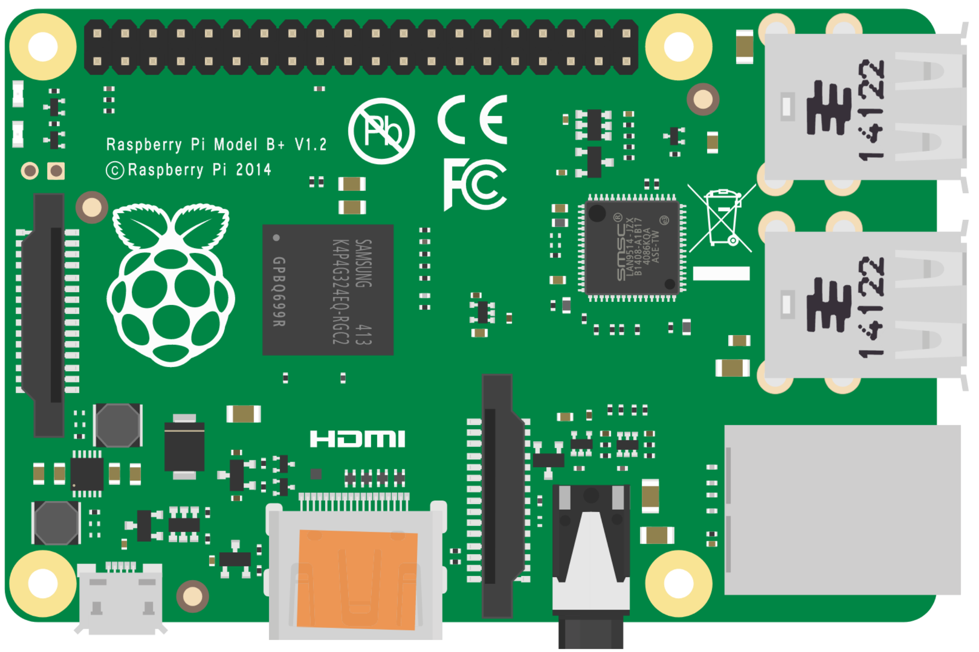
The FoodWise Device
Raspberry Pi
Touch Screen
Barcode Scanner
The device runs on a Raspberry Pi mini computer
Users can interact with the device using the connected touch screen
The products are scanned with a barcode scanner that is connected to the Raspberry Pi

Slide 8
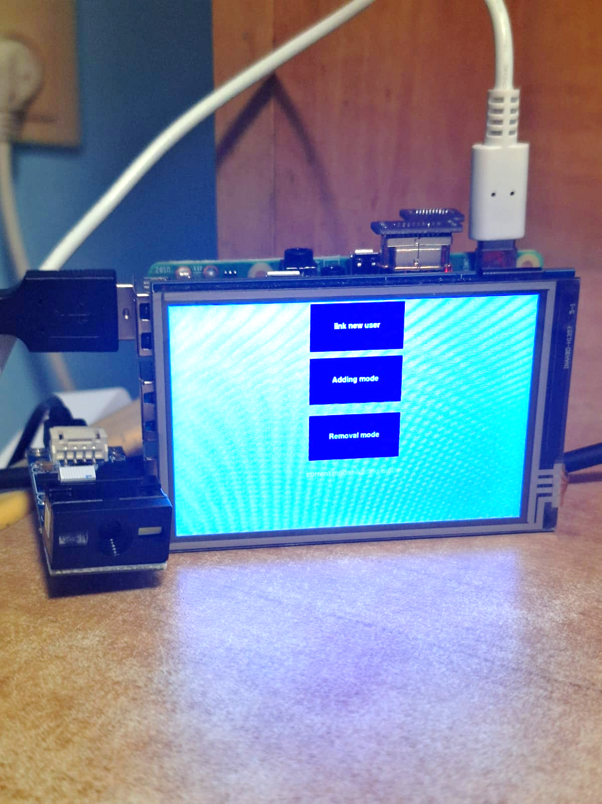
The FoodWise Device
Raspberry Pi
Scanner
Touch Screen

Slide 9
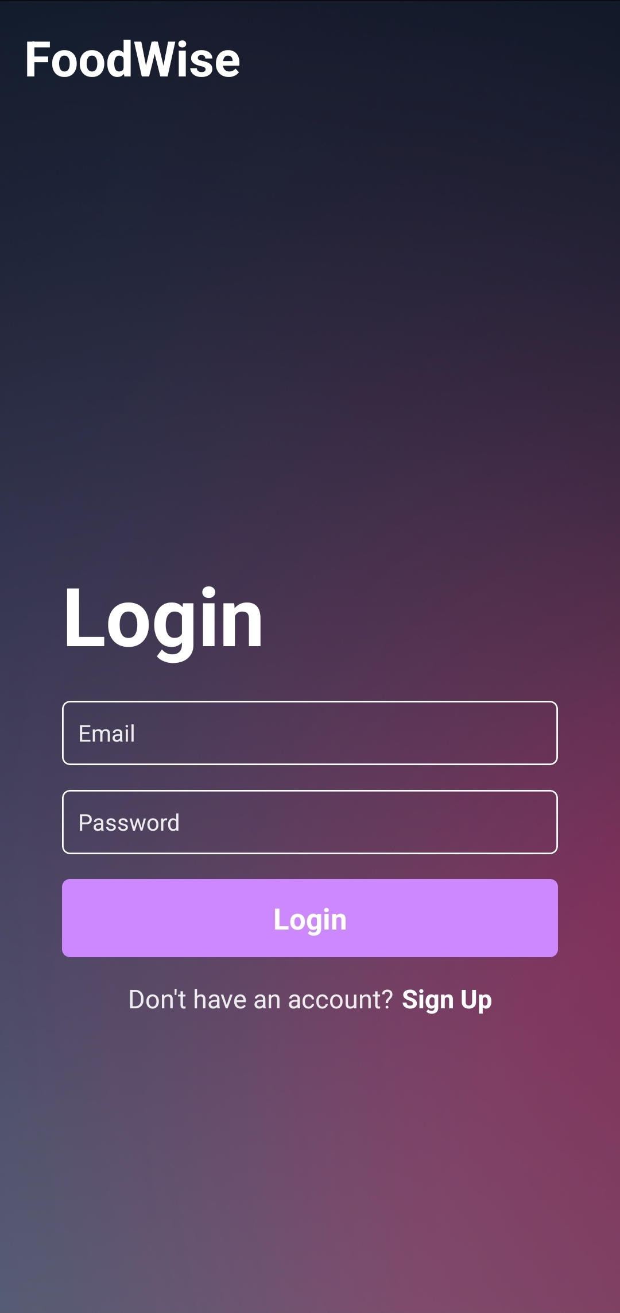
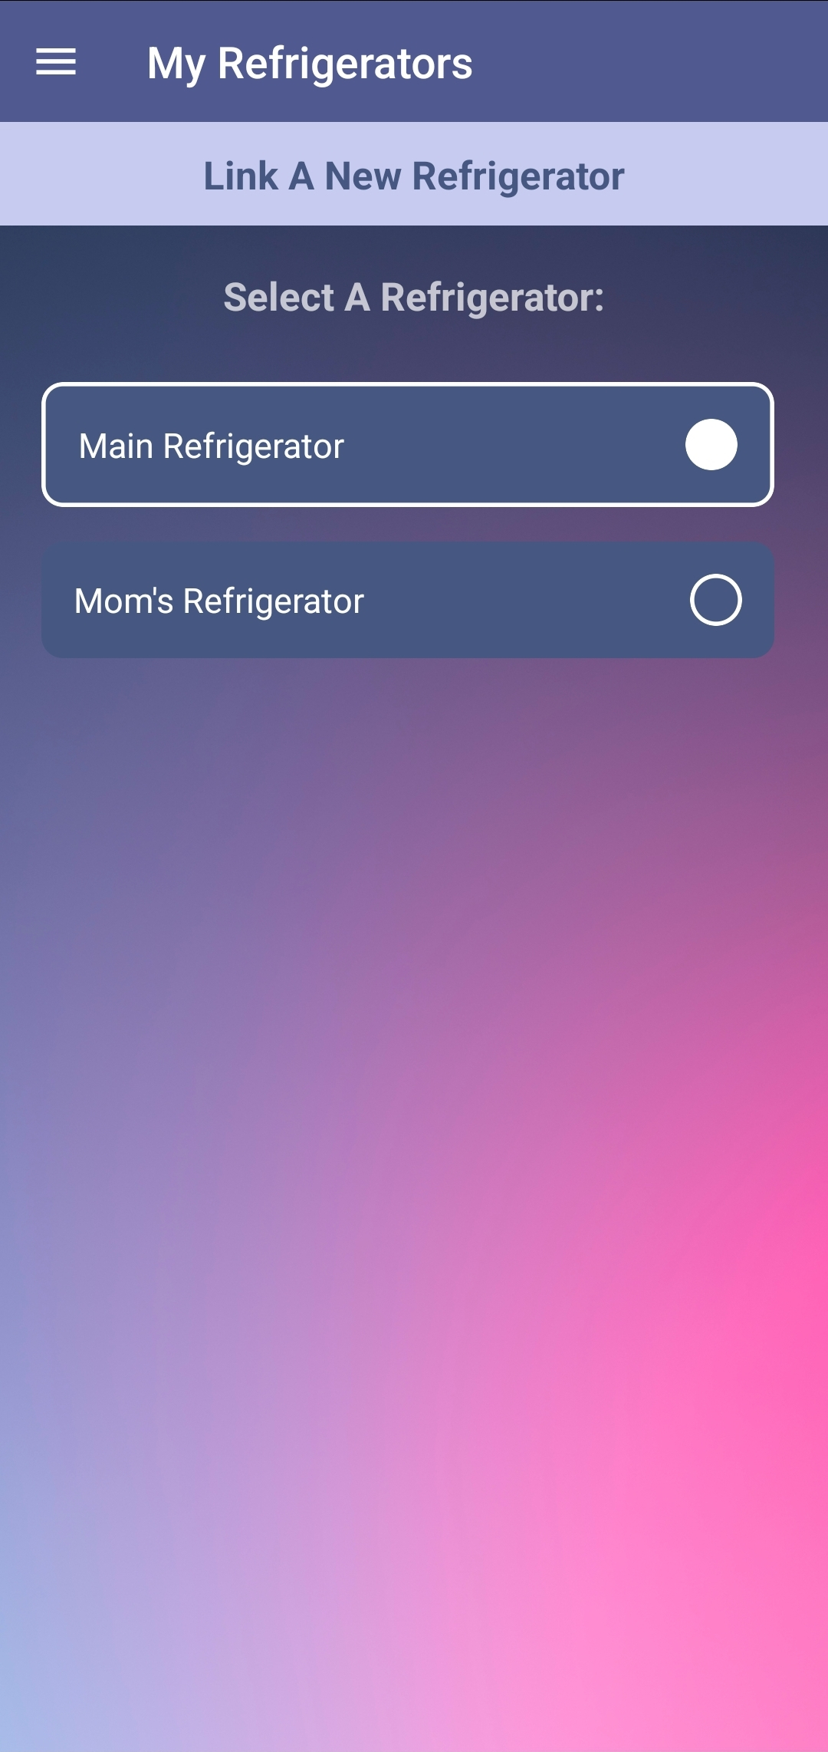
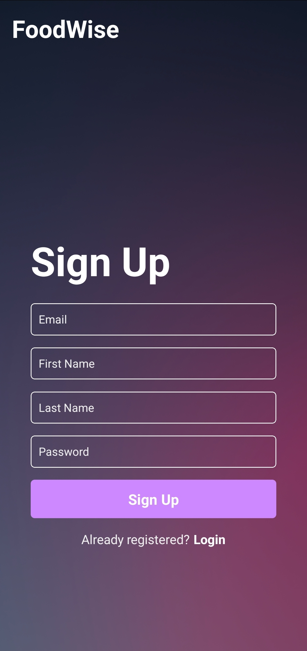
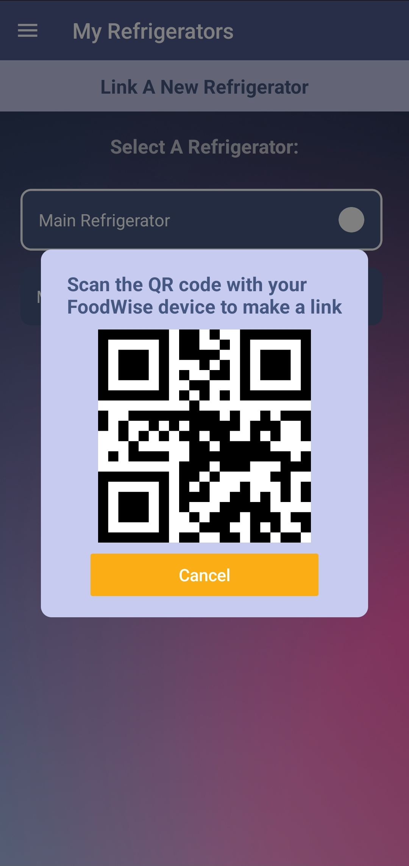
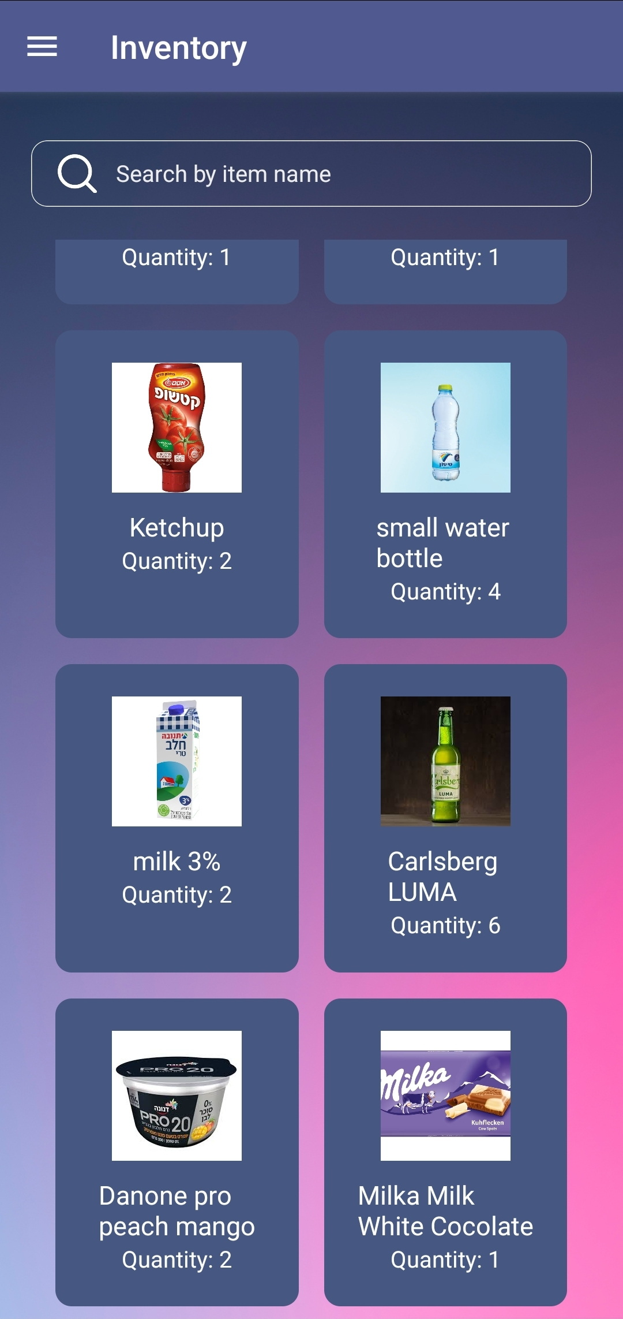
The FoodWise Mobile App

Slide 10
Features
Real-time Inventory
Automated Shopping Lists
Management of food inventory through seamless item scanning. Real-time inventory updates, allowing users to view and modify the list through the app.
Generation of a shopping list by analyzing the scanned inventory data with the user’s configuration.
Recipe Suggestions
Consumption reports
Personalized recipe suggestions based on available ingredients in the refrigerator.
Detailed weekly consumption reports and statistics.

Slide 11
03
Structure And Architecture

Slide 12
Architecture
RESTful API
FoodWise IOT Devices
Json Response
SQL Query
RESTful API
Json Response
Cloud Server
SQLite Database
Mobile App

Slide 13
Embedded Tech Stack
Raspberry Pi OS
Python
A stable and optimized environment, seamless integration and reliable performance.
Versatility and extensive libraries make it ideal for interacting with hardware components.

Slide 14
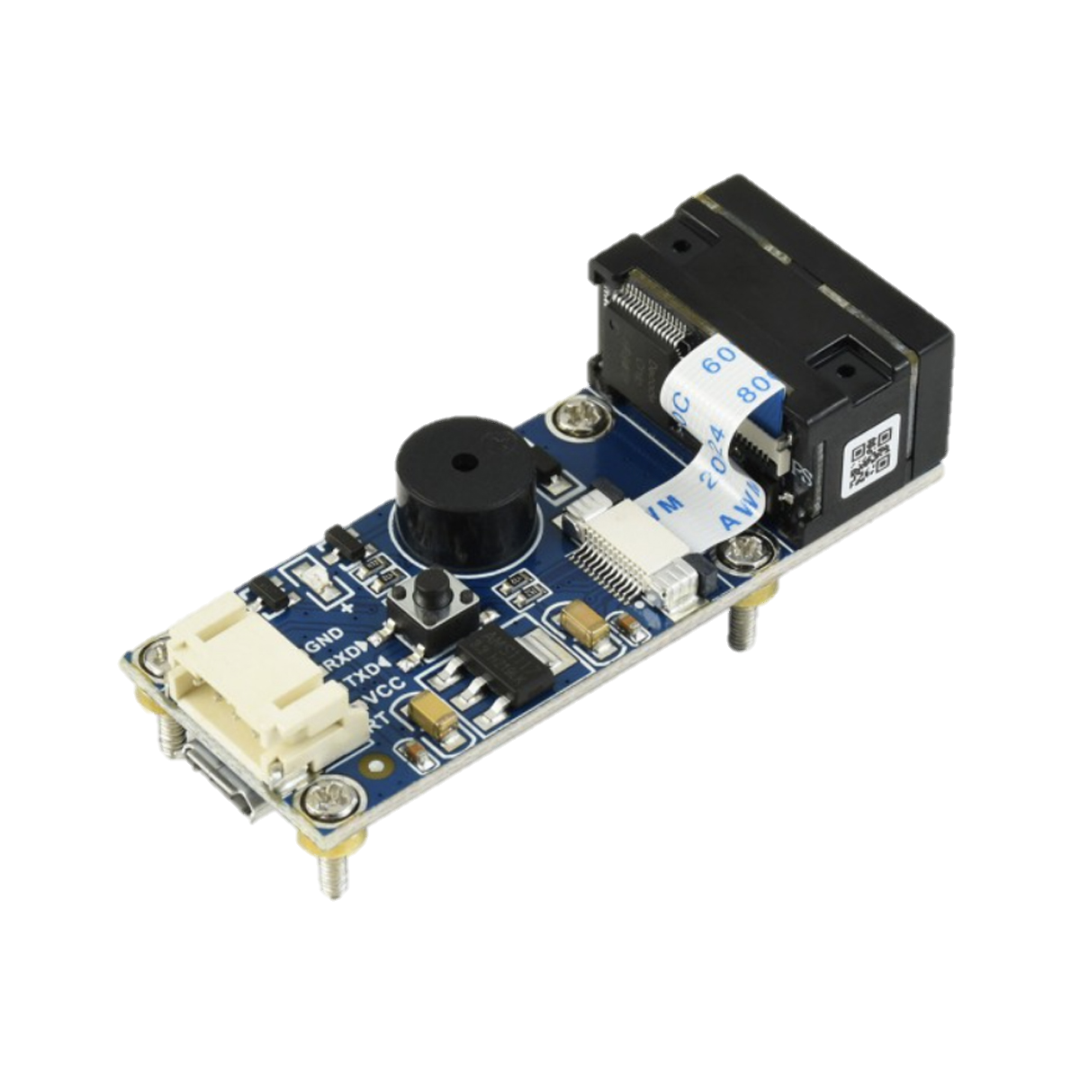
Embedded Structure
The structure includes two concurrent threads, operating simultaneously:
Main Thread
Scanning Thread
-Manages the user interface with three buttons for mode switching (add, remove, link), implemented using the Tkinter library in Python.
-Additionally responsible for communication with the server, implemented with the requests library in Python.
Acts as a barcode event listener, handling scans events, implemented with the evdev library.

Slide 15
Backend Tech Stack
Python
Flask
SQLite
Simplicity, readability, and extensive libraries, making development efficient and scalable.
Lightweight and modular design, flexibility and ease of use
lightweight, self-contained nature, requiring minimal setup and administration.

Slide 16
Backend Structure
We've set up a monolithic API server on the PythonAnywhere cloud platform.
The server include 2 Types of endpoints:
For Embedded Devices
For Frontend Devices
These endpoints manage tasks like adding/removing products ,linking users with refrigerators.
This set of endpoints handles tasks like user authentication and refrigerator content.
Our Database
A database to store all the necessary data for the required services.

Slide 17
Backend API
Our Servers API
Embedded endpoints
Frontend endpoints
POST /register
POST /scan
POST /user_login
GET /request_refrigerator_id
GET /linked_refrigerators
POST /link
GET /refrigerator_content
GET /number_linked_refrigerators
POST /update_refrigerator_name

Slide 18
Frontend Tech Stack
React Native
Popular framework, cross-platform mobile applications, allows for rapid development and provides native-like performance and user experience. Have extensive libraries and community support.

Slide 19
Frontend Structure
Screens
Navigation
The Mobile App includes various visual screen components, such as Inventory, login/signup, refrigerator selection and more.
Use of React Native Navigation library to navigate the app.
Utilized Stack and Drawer navigators.
Core Concepts
Backend Communication
Use of React Natives core concepts such as Hooks, Components, etc.
Uses Axios to send HTTP Requests to our Backend server.

Slide 20
04
Our Progress

Slide 21
Current Status
Scanner Configuration
Adding/Removing items from a refrigerator
Users Login and Signup through the mobile app
Linking a user to a refrigerator
View Real-Time Inventory
Support of multiple refrigerators per user

Slide 22
Whats next?
Shopping list generation
Recipes generation based on inventory
Personalized Notifications
User Profile
Weekly consumption reports

