Slide 1


GoldenFrame
Project number : 15001223
Presented at Workshop:Software Product
Developed by : Moshik Yifrah, Guy Hanan, Irad Amsalem
Guided by Amir Kirsh

Slide 2
❌ The Problem
Many people struggle to choose the best photo for their profile or social media post.
Even when they have dozens of pictures, it’s hard to tell:
Which one looks the most professional?
Which photo will get more likes or engagement?
Which image sends the right message for a specific purpose (e.g., business vs. dating)?
As a result, users often upload unflattering or unsuitable photos, missing the chance to make a strong first impression.

Slide 3
🎯 Target Audience
📱 Active social media users – Instagram, Facebook, TikTok
👩‍💼 Job seekers and students – looking for the perfect LinkedIn or CV photo
💘 Dating app users – who want to boost their profile with the right photo
📸 Anyone with multiple photo options – and wants a smart, objective recommendation

Slide 4
✅ The Solution – GoldenFrame
GoldenFrame offers a smart and simple solution to the photo selection dilemma:
The user uploads several personal photos
Chooses the purpose of the photo (e.g., Instagram profile, LinkedIn, dating app)
The system performs advanced visual analysis: sharpness, brightness, colors, facial expressions, and more
The app ranks the photos by relevance – showing the best match first
🔁 The app learns the user over time:
As the user gives feedback or as the system gathers results (such as likes, comments, or actual photo selections), it adjusts its recommendations to better match the user’s personal style and preferences.
🧠 The result: a personalized experience that improves with every use.

Slide 5
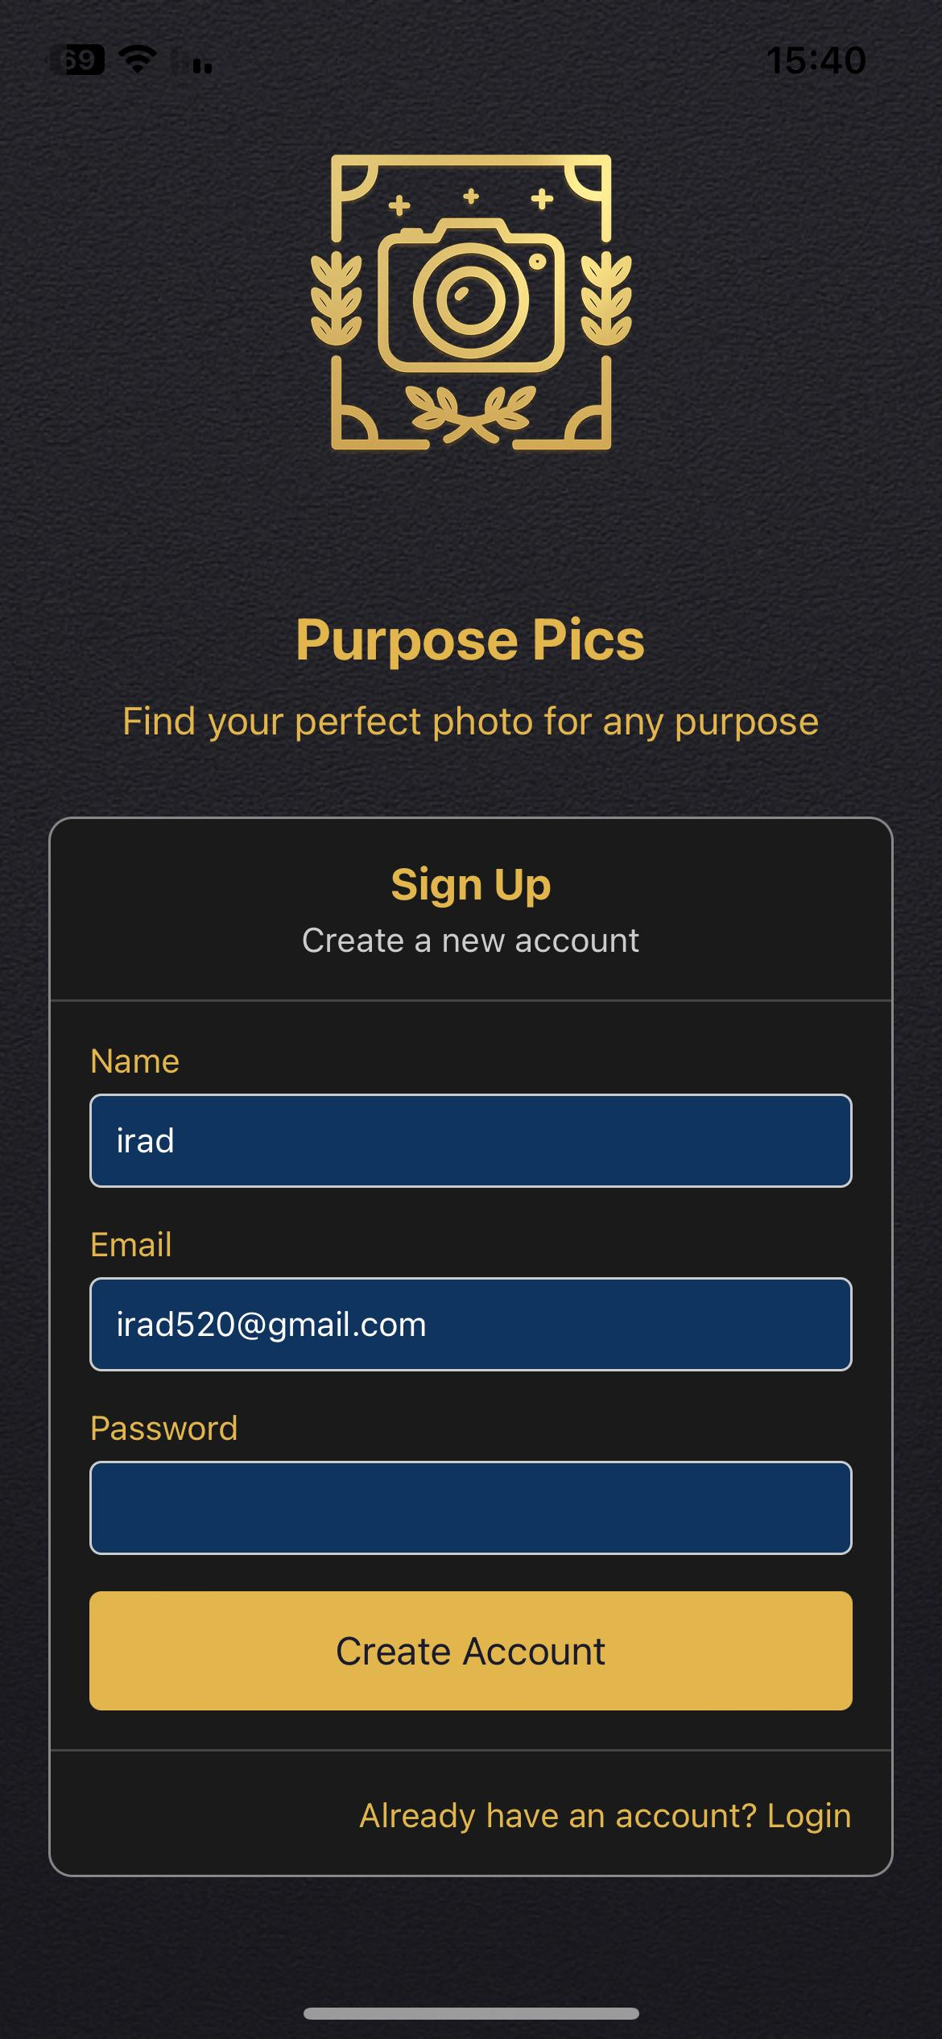
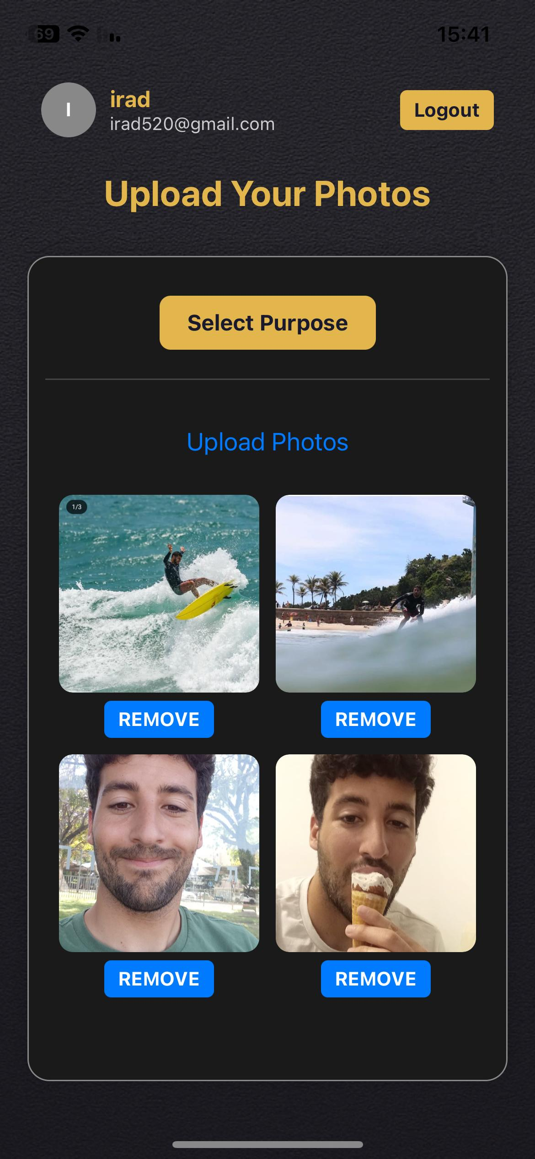
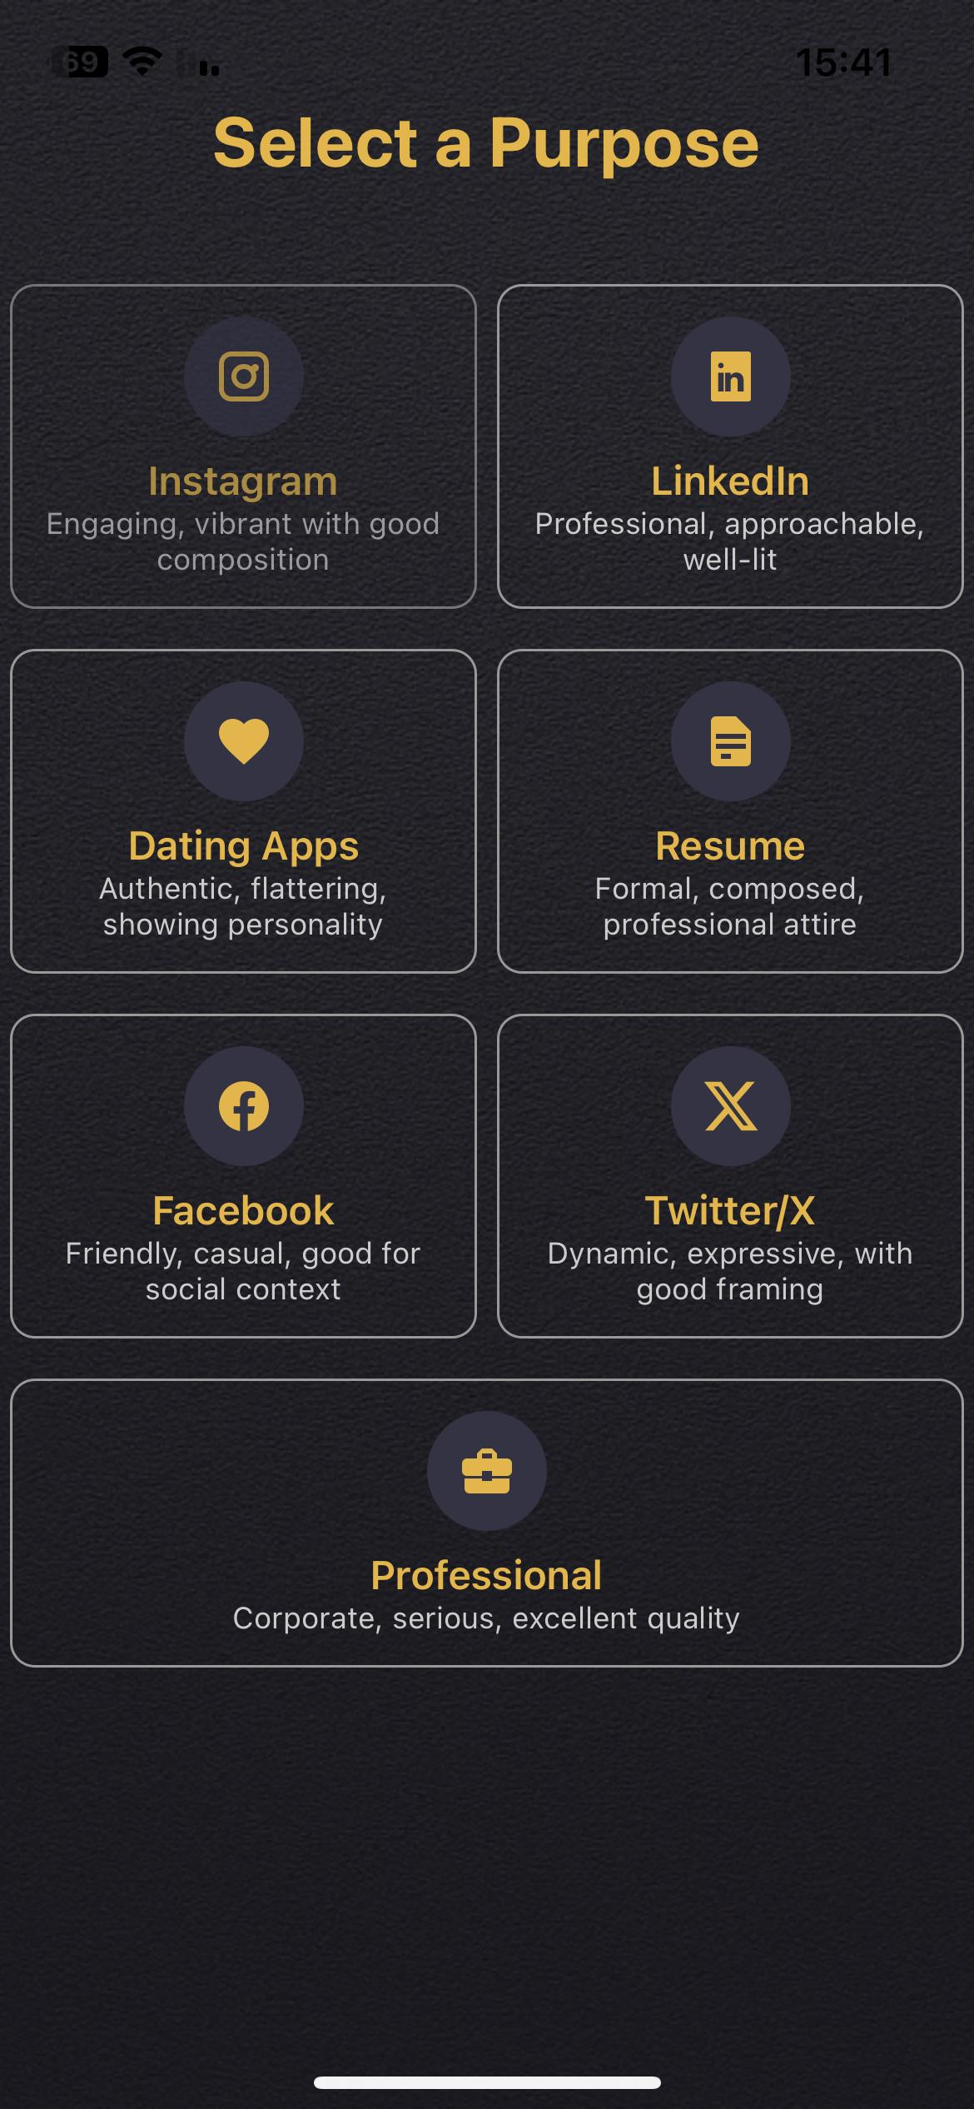
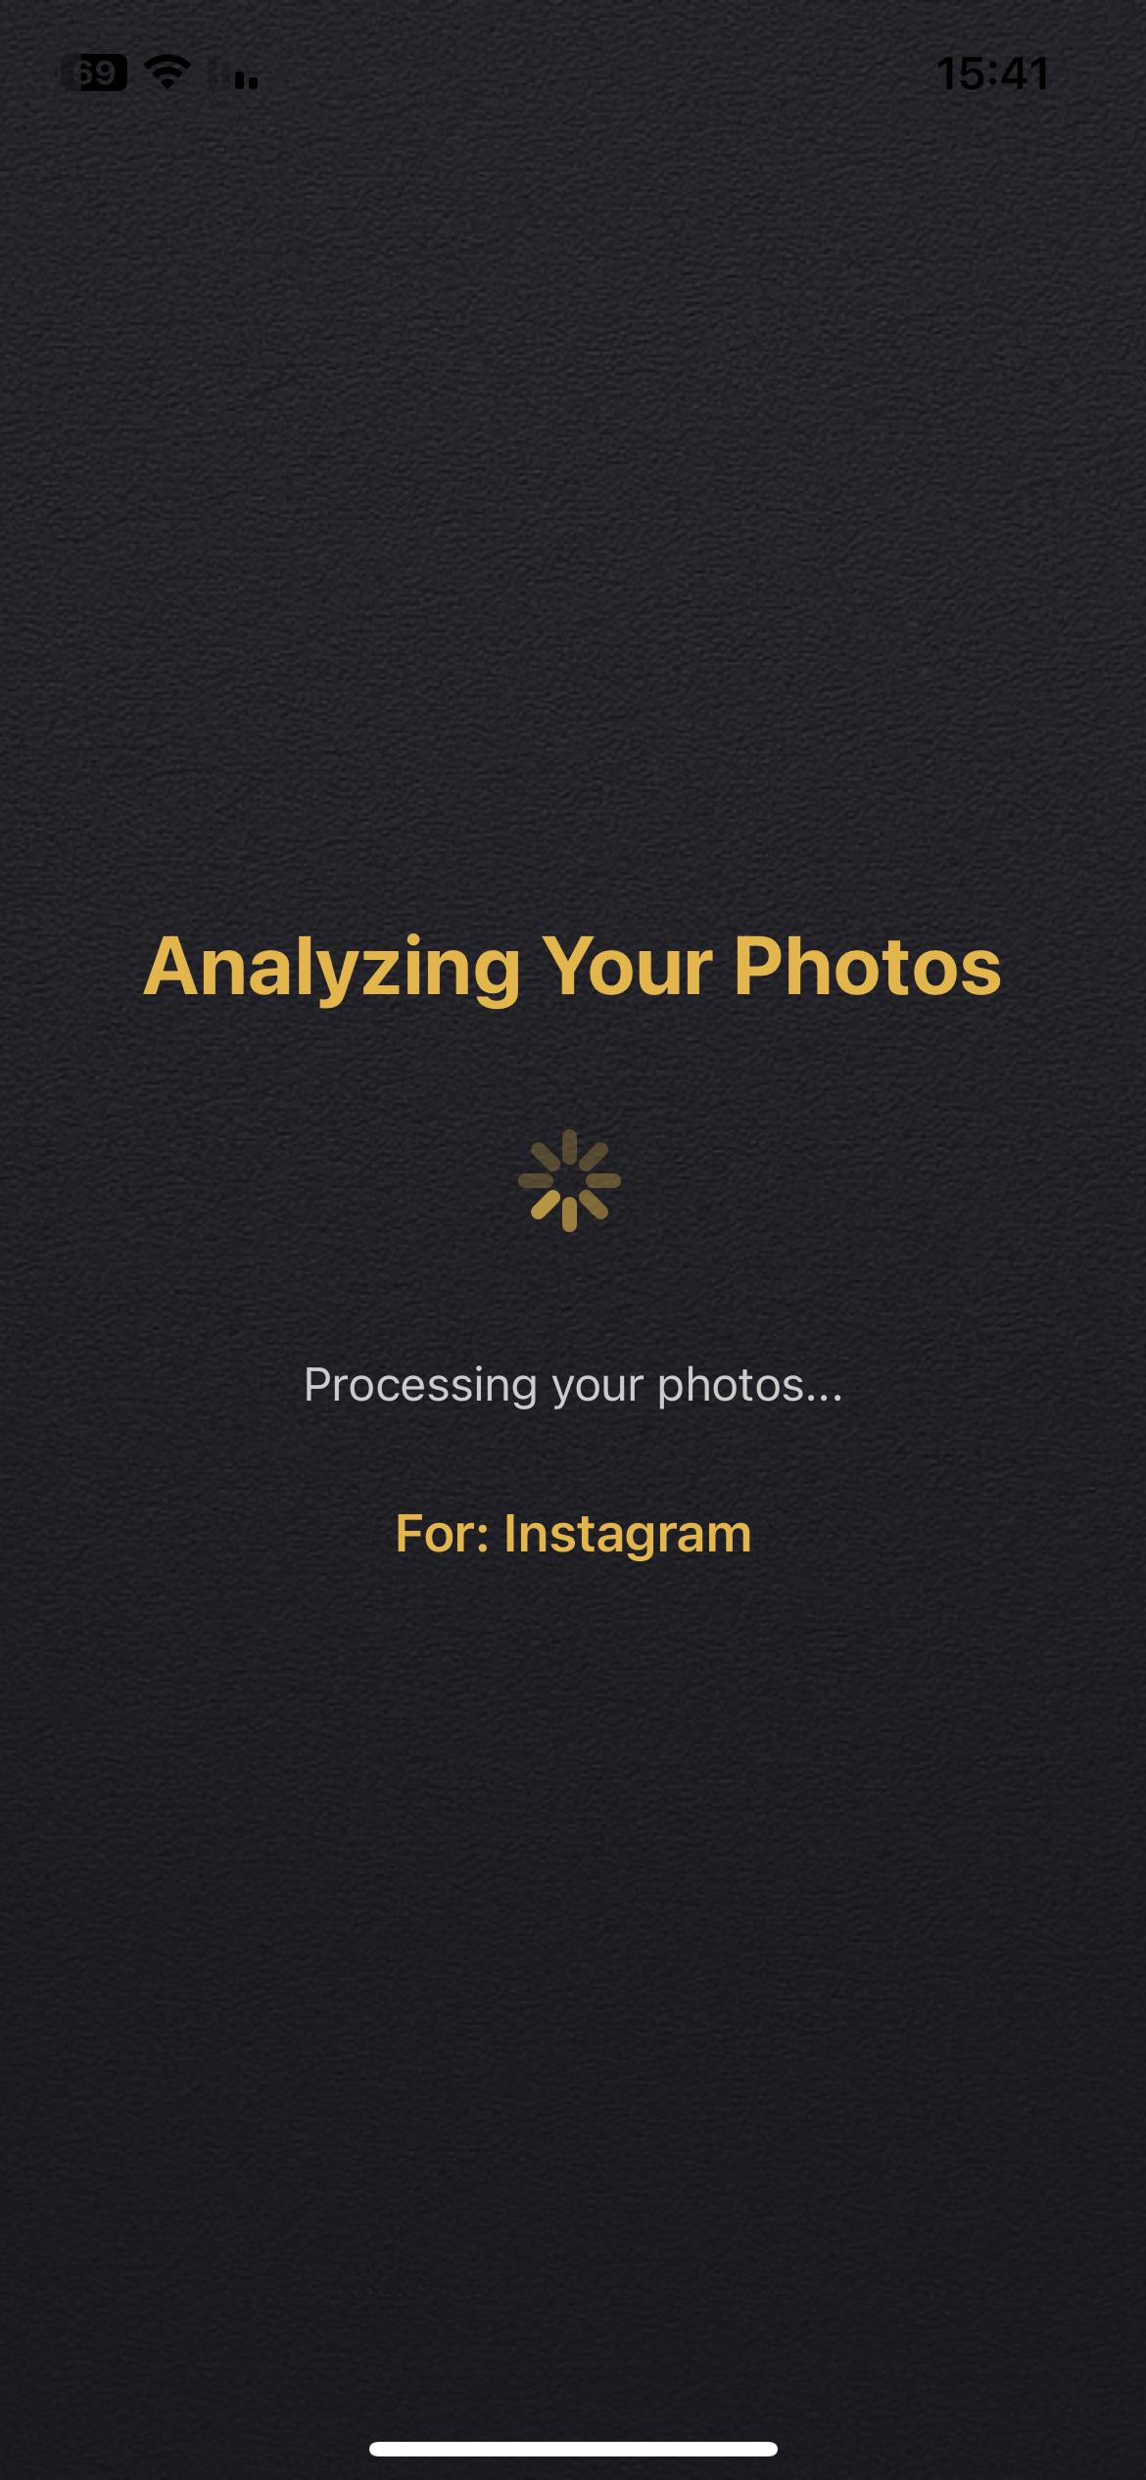
1
Open new account
2
Upload photos
3
Select purpose
4
analyzing

Slide 6
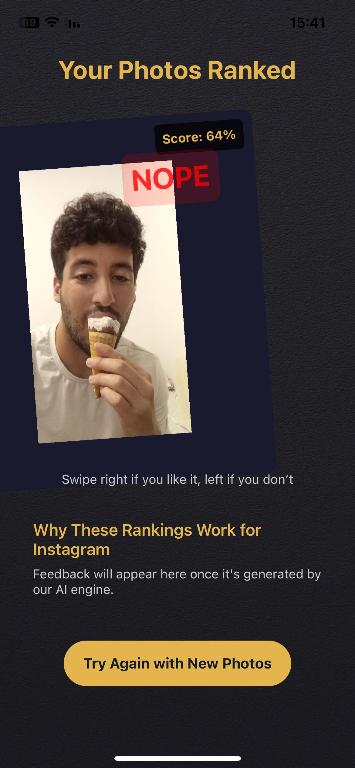
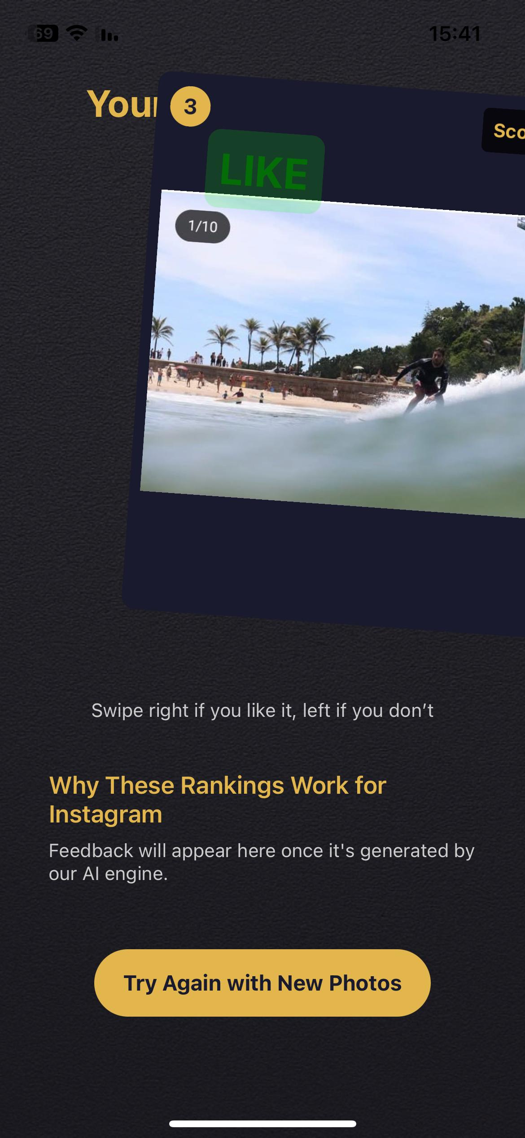
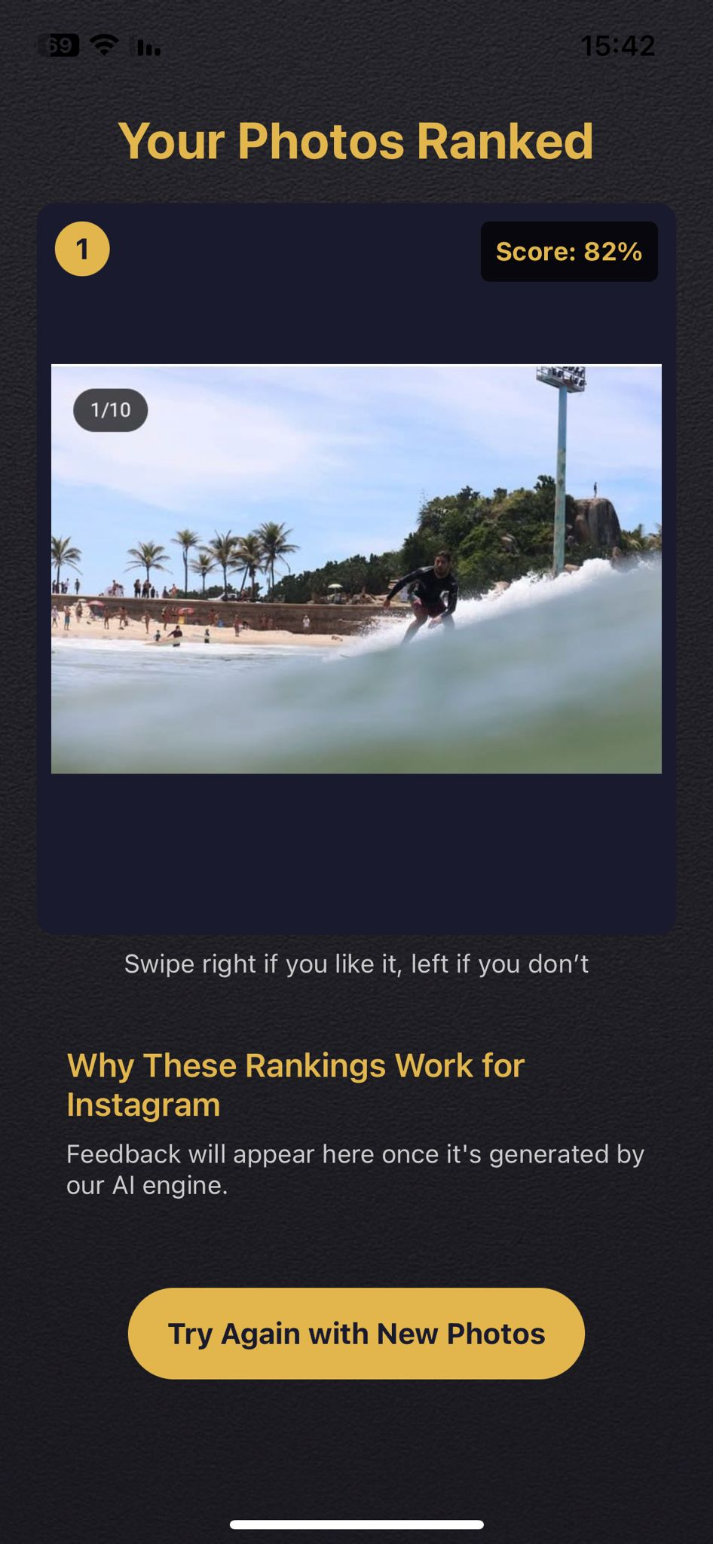
5
Unlike selfies
6
Like surfing photos
7
Upload same photos again
As we can see, the application has learned the user and is now offering surfing photos as a top priority.

Slide 7
Frontend (React Native)
Sends request with photos, email, password, and selected purpose
Backend (Node.js + Express)
Frontend
Displays ranked photo results to user
Receives final visual + semantic scores
User
User chooses the best photo
User
Uploads photos + selects category (Instagram, LinkedIn, etc.)
- Zod ✅
Validates input data
Bycrypt -🔐
Hashes password before storing
Google Vision -🧠
Extracts labels, faces, colors, sharpness, etc.
MongoDB -🗂️
Stores user data + vision labels
Python (HuggingFace + LangChain) - 🤖
Embeds labels (MiniLM)
Compares to purpose vector using cosine similarity

Slide 8
🆚 Existing Solutions vs. GoldenFrame
📸 Existing Solutions:
❓ Manual selection – users choose the photo that feels right, with no objective analysis
👥 Asking friends – sharing photos via WhatsApp groups or Instagram polls for feedback
🧠 Generic AI tools – some tools analyze photos based on basic metrics (e.g., brightness or symmetry), but don’t consider the photo’s purpose or the user’s personal style
🌟 Why GoldenFrame is Better
🎯 Tailored to the specific goal – Instagram, LinkedIn, dating, and more
🔁 Learns the user over time – personalized recommendations based on feedback and usage
🧠 Uses advanced analysis – combining visual metrics, facial expressions, sharpness, color balance, and overall style
⏱️ Fast, simple, and user-friendly – no need for technical knowledge or outside opinions

Slide 9
🧾 Project Summary & Conclusions
GoldenFrame offers a smart, innovative solution to a real-world need in the age of social media and personal branding
By combining advanced visual analysis with personalized user learning, it creates an effective and user-friendly experience
The app saves time, reduces uncertainty, and helps users choose the best photo with confidence
The more the app is used – the smarter and more accurate its recommendations become
📈 Conclusion:
Merging technology with personal insight creates a valuable tool in today’s highly visual world.

