Slide 1
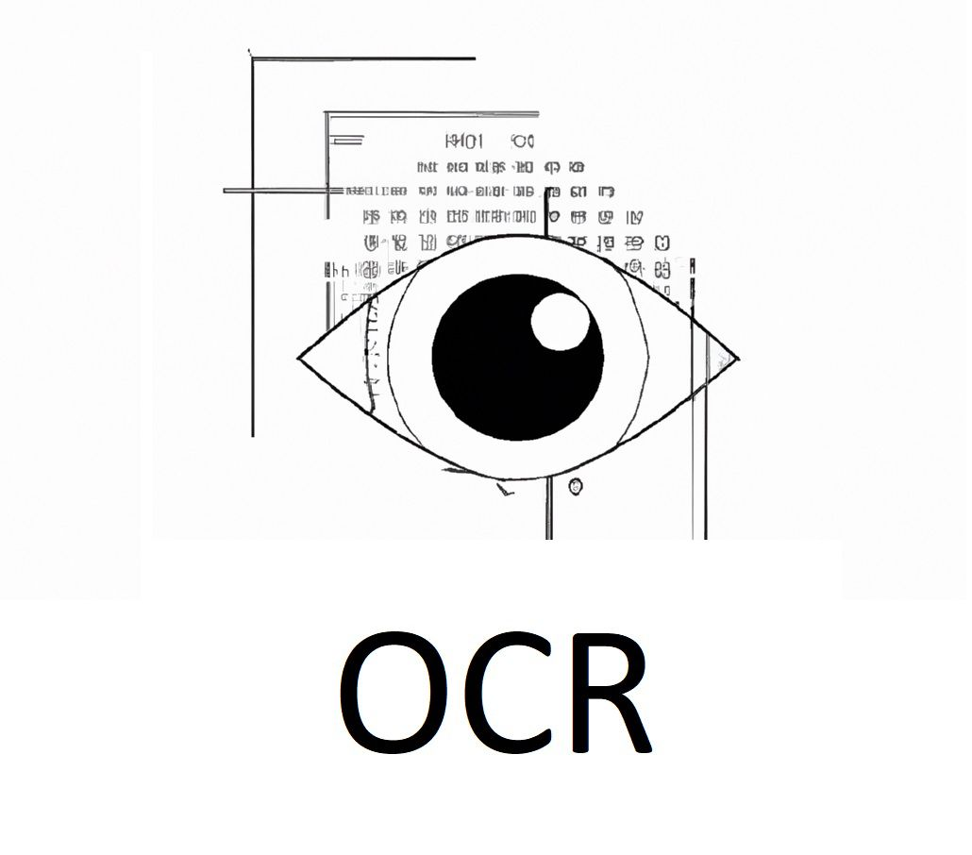
מס' פרויקט: 231308
סטודנטים: דולב יפרח, עידן רוזנברג, סער צור, תומר שטרנברג, נטלי עליזי שם המנחה: ד"ר שראל כהן

Slide 2
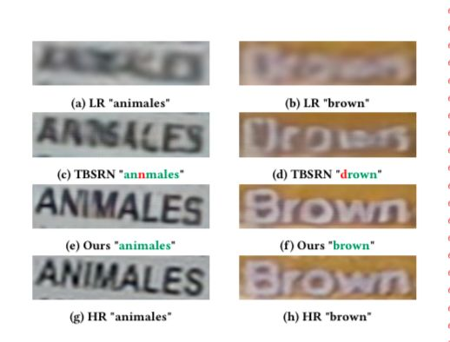
Problem Description
In this workshop, we train and run models to decode text from an image
(a problem known as OCR = Optical Character Recognition), emphasizing texts that are difficult to read at low resolution.
The study proposes a new approach that combines image super resolution, image restoration, and optical character recognition techniques to improve text recognition in real-life images.

Slide 3
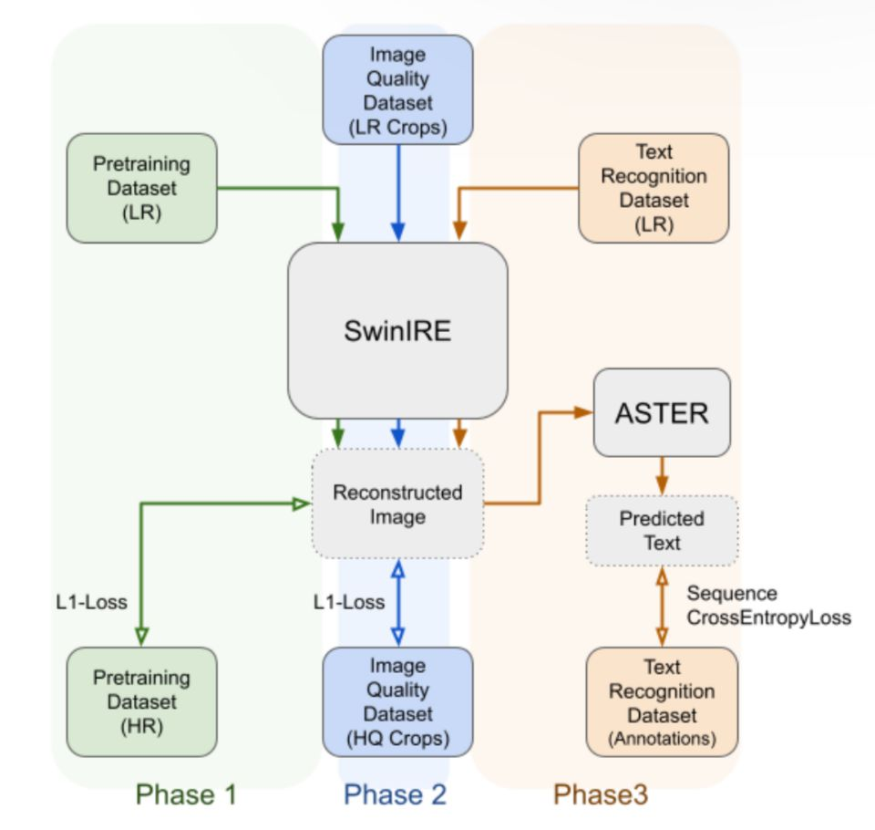
Solution Description
A Transformer-based network is used, and combine a network that performs Super Resolution together with a network for recognizing the text in the image.
The networks learn together end-to-end using a loss function that also represents the magnification quality and the detection quality.

Slide 4
Solution Architecture
Swin Transformers, particularly SwinIR, have made significant strides in the field of single image super-resolution. The training consists of three training phases: sequentially training SwinIRE on single image super-resolution, image super- resolution combined with image restoration and fine-tuning it with the Sequential Cross-Entropy Loss for text recognition.
In the final phase, the model is fine-tuned using the Text
Recognition Dataset with a reduced learning rate.
Unlike previous stages where L1 loss is used, the text recognition loss of ASTER to guide the
training process of the model.

Slide 5
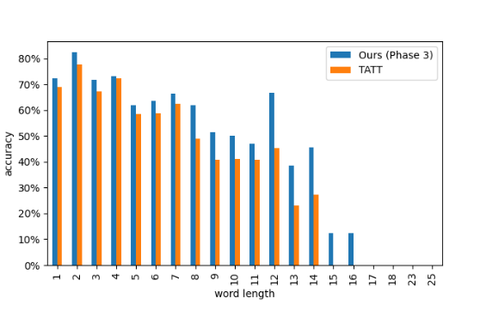
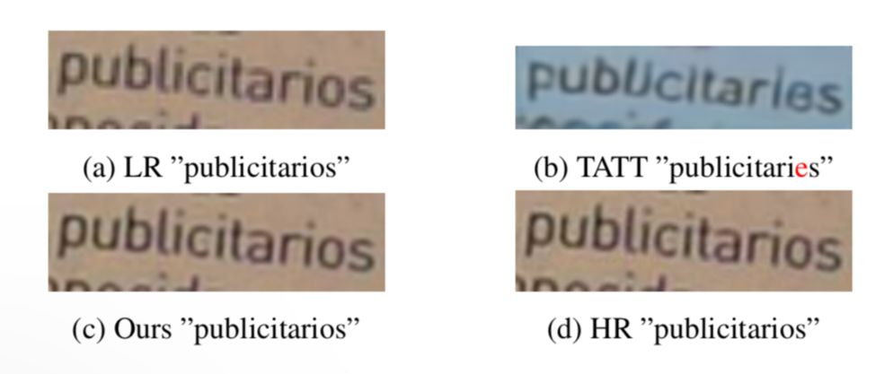
Other approaches to OCR
Unlike previous studies, it is emphasized that the possibility that texts will arrive in a varied aspect ratio and train the network to deal with images of different sizes by increasing the image resolution, thus achieving an improvement over similar networks for this problem.
Compared to previous state-of-the-art models, such as TATT, the new model can improve results significantly

Slide 6
Project summary and conclusions
Super resolution can improve OCR Text recognition aware training is sufficient to optimize an image super resolution model to work on text State-of-the-art performance was achieved at a smaller model size than the previously best model on this dataset (less memory and energy consumption, faster execution time on smaller devices)

